Slide 1
Secure Time Synchronization in Power Grids and Network HIL Synchrophasor Testing
June 4
Mohammed Olama
Oak Ridge National Laboratory

Slide 2
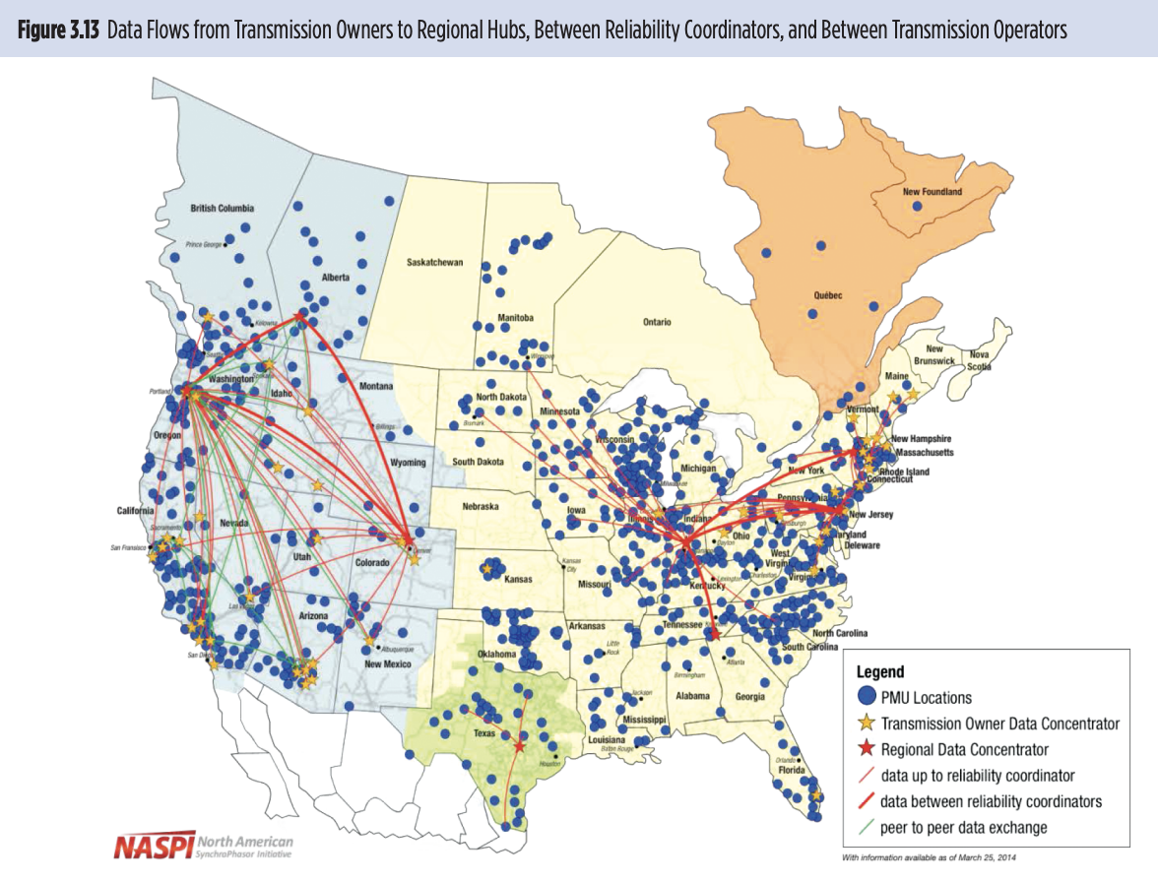
Synchronization is Essential for Power Grid Operation
Timing and synchronization are critical to grid operations in many traditional ways
  OT device operations, IT services orchestration, data logging, etc.
Timing is also critical to highly specialized grid use cases
  Power system protection
  Wide-area monitoring, protection, and control (WAMPAC)
  Frequency stability and load balancing
  Electrical event reconstruction
55,000+ substations with 1+ GPS antenna in the US
Thousands of networked PMUs deployed throughout the US (2015)
Image source: DOE Quadrennial Technology Review (2015) https://www.energy.gov/sites/prod/files/2017/03/f34/qtr-2015-chapter3.pdf

Slide 3
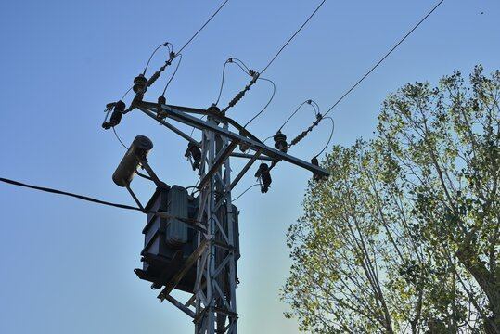
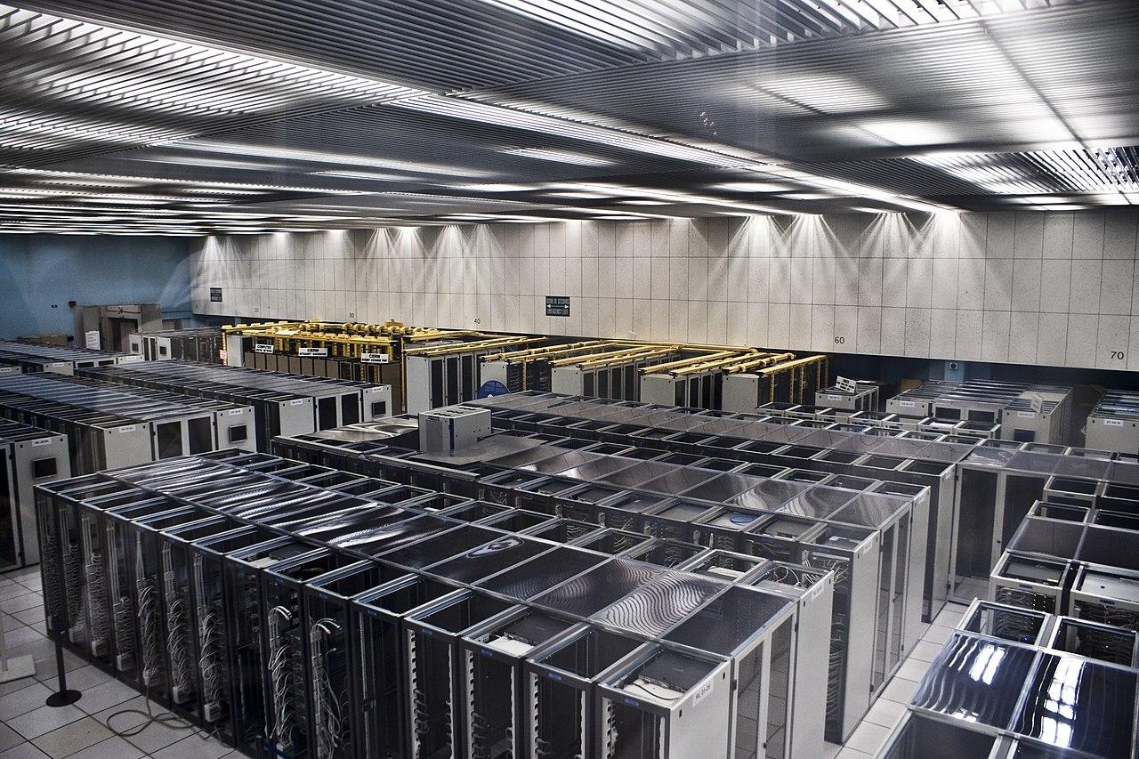
Timing & Synchronization Now More Important than Ever
Distributed generation is bringing thousands of new devices online
Shift in grid structure and operations
  Consumers = producers (bi-directional flows)
  Data centers, Distributed control
Wide-area monitoring through precision sensors and advanced analytics is critical to this transition
Time synchronization across the sensors (and operational zones), to support analytics and inferencing, is necessary
Image source: https://commons.wikimedia.org/wiki/Category:Data_centers#/media/File:CERN_Server_03.jpg
Image source: https://commons.wikimedia.org/wiki/File:Car2Go_Charging_Station_Stuttgart_2013_01.jpg

Slide 4

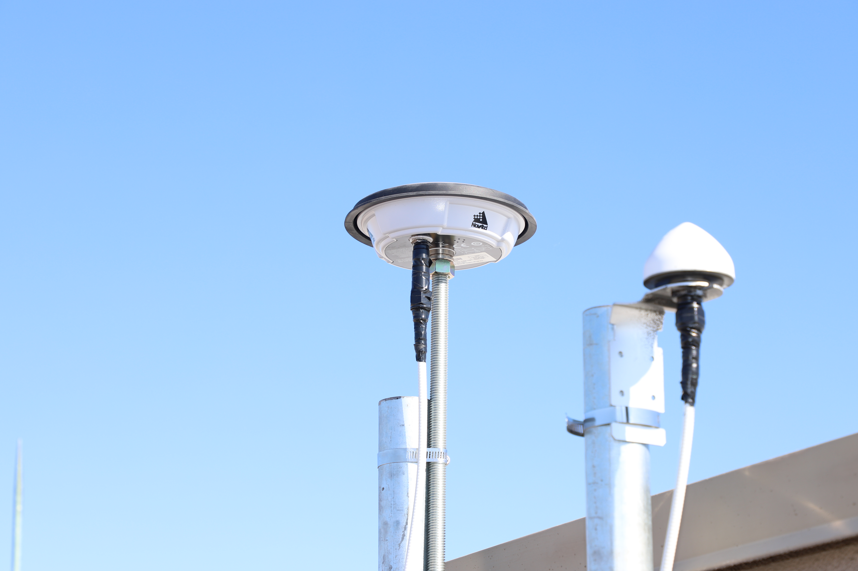
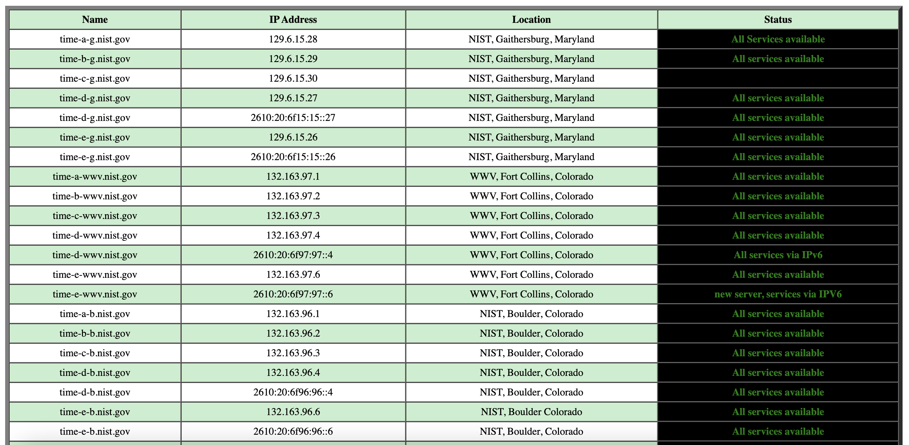
Timing and Dissemination Today
Timing for deployed grid assets and systems today is largely delivered by GPS (GNSS)
Timing for IT systems operating the grid is largely delivered by Network Time Protocol (NTP)
GPS antenna installation at WAPA site
Representation of GPS satellite
NIST NTP service dashboard
NIST image source: https://tf.nist.gov/tf-cgi/servers.cgi
GPS image source: https://www.gps.gov/multimedia/images/GPS-III-A.jpg

Slide 5
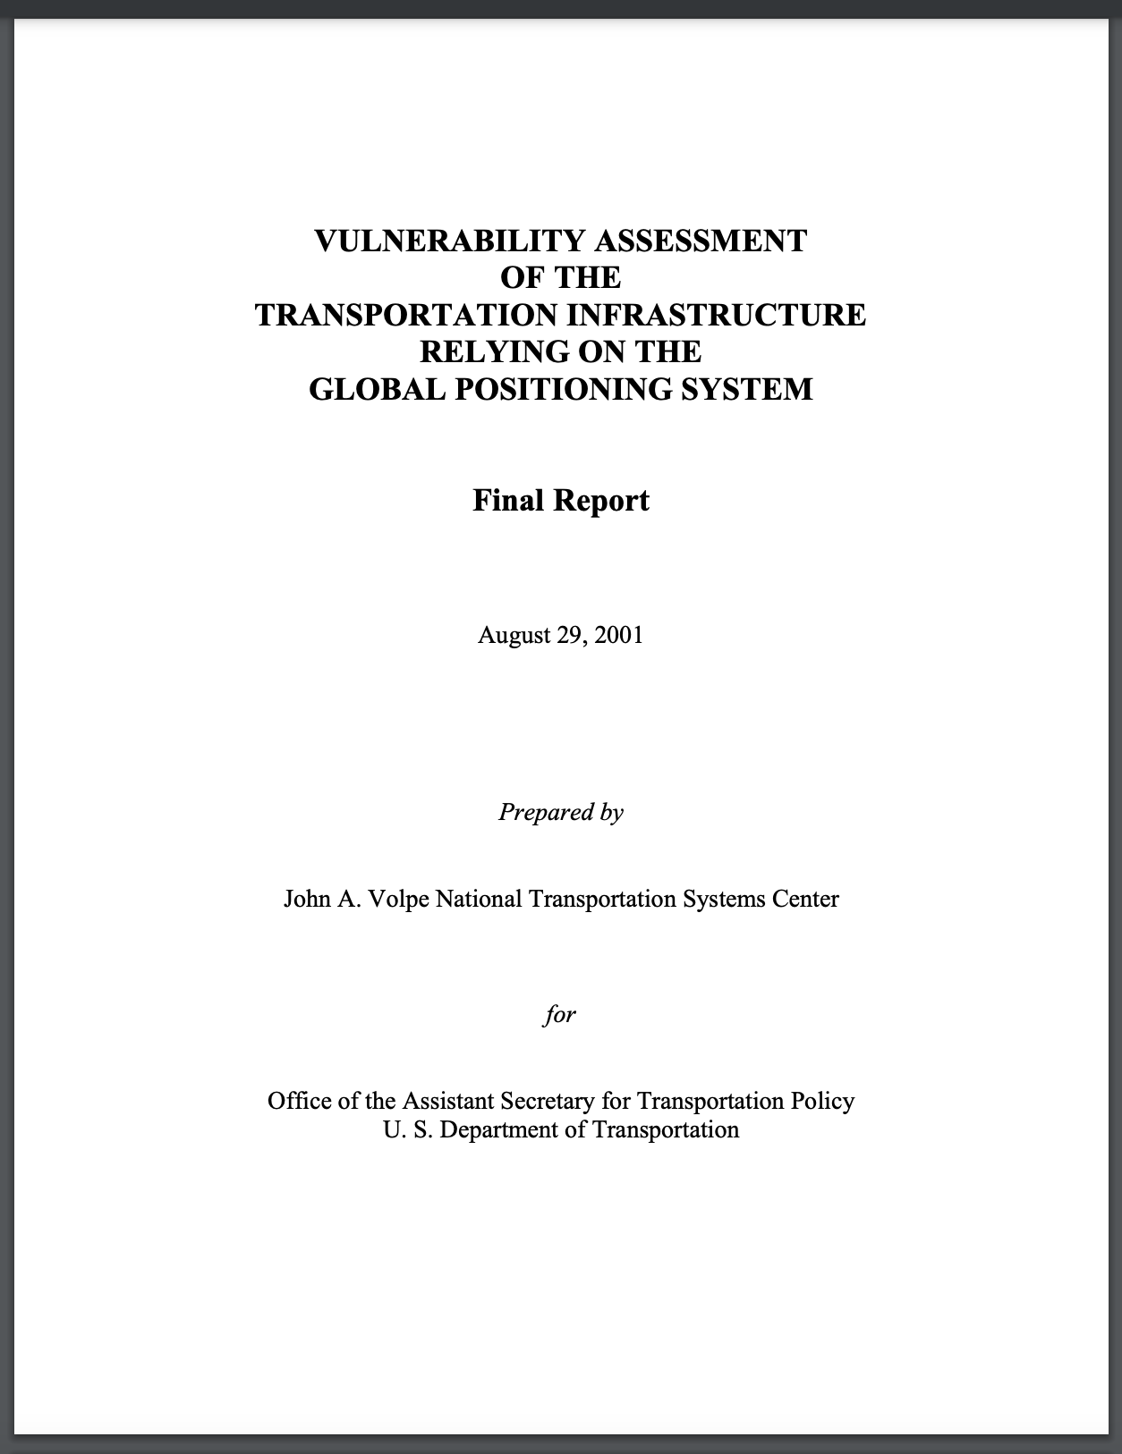
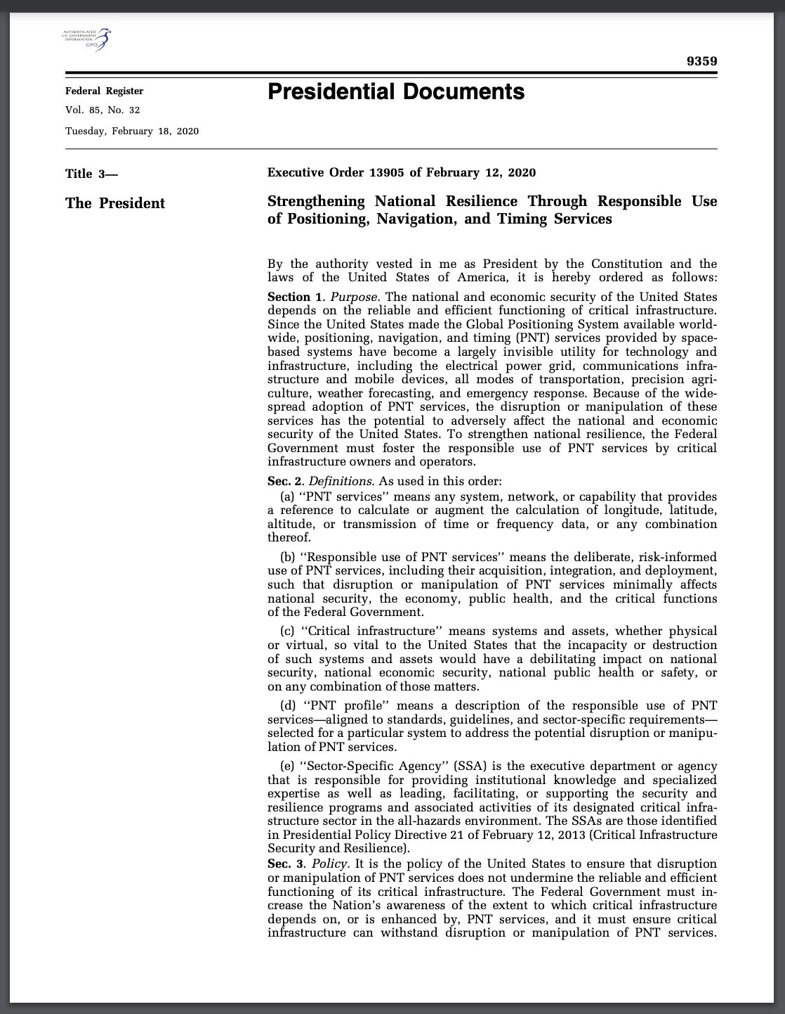
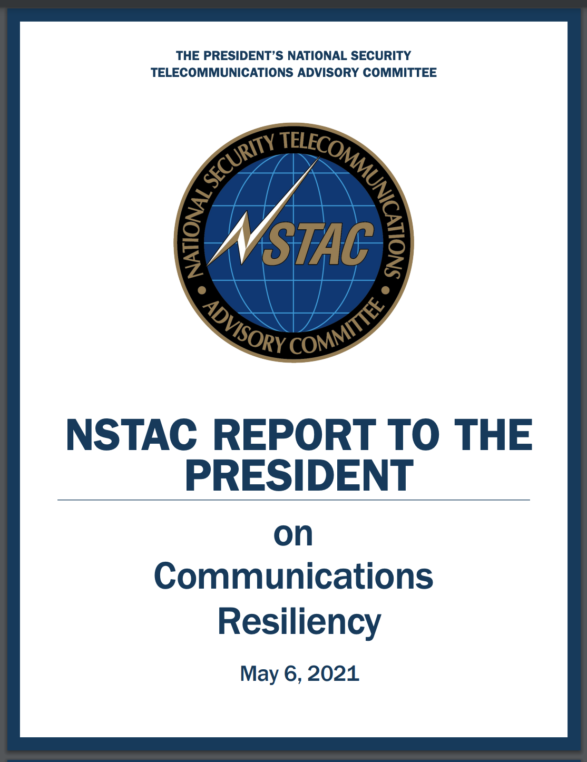

GPS Risks and Vulnerabilities are Driving New Investments
GPS vulnerabilities and the need for resilience have been well-documented
  Signal is known and unencrypted
  Jamming, spoofing accomplished with off-the-shelf gear
NTP delivered via unencrypted service, vulnerable to being a cyber intrusion vector (e.g., man-in-the-middle attack)
A more secure time delivery system is needed to ensure grid resiliency in the face of cyber threats.

Slide 6
ORNL Timing & Synchronization Test Bed:
Center for Alternative Synchronization and Timing (CAST)
One-of-a-Kind Technology Baseline
Industry and Lab Partnerships for Testing and Development
Multiple atomic clocks
  Three cesium clocks
  Eight rubidium clocks
Multiple communications networks integrated to the lab
Variety of routers, switches, and firewalls for testing and benchmarking
Hardware Partners
  Adtran/Oscilloquartz
  Arista
  Juniper
  Microchip
  Nokia
  Palo Alto
  Safran/Orolia
Communications Partners
  ESNet
  AT&T
  InMarSat
  Iris Networks
  SES
  Verizon
R&D and Testing Partners
  Idaho National Lab
  Sandia National Lab
  Pacific Northwest National Laboratory
  Savannah River National Lab
  National Institute of Standards and Technology (NIST)
  Tennessee Valley Authority (TVA)
  Electric Power Board of Chattanooga (EPB)
  Dominion Energy
  Western Area Power Administration (WAPA)
  Bonneville Power Administration (BPA)
  Dark Fiber
  DWDM
  Carrier Ethernet
  OTN
  Copper
  DOE ESNet
  Cellular+5G
  Ku-band SATCOM
  Satellite Internet
  Microwave

Slide 7
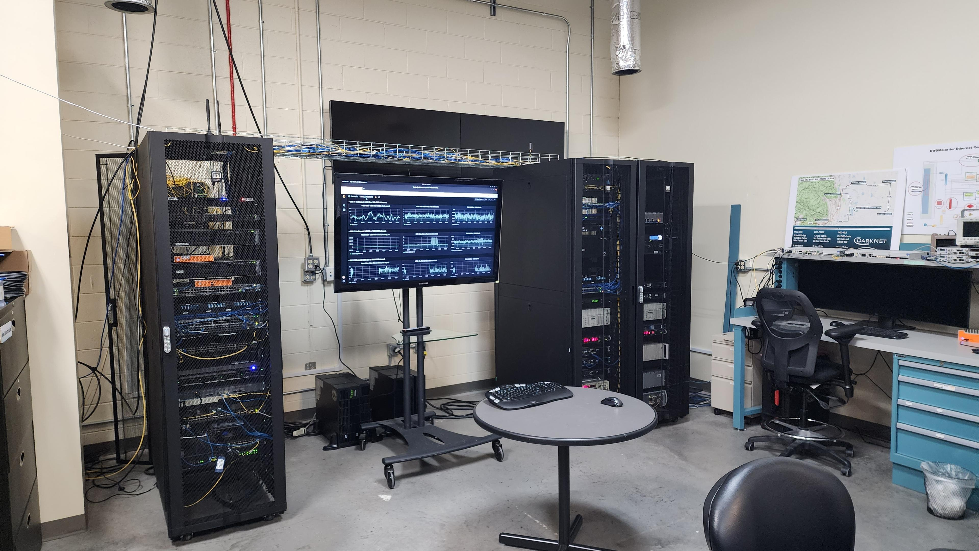
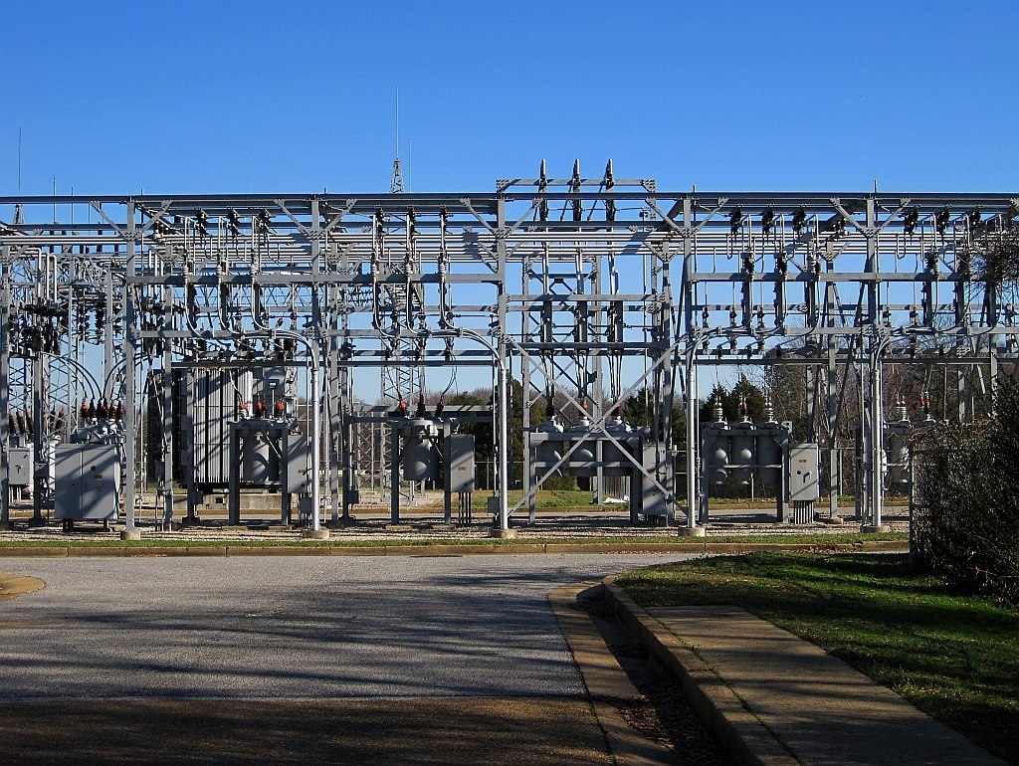
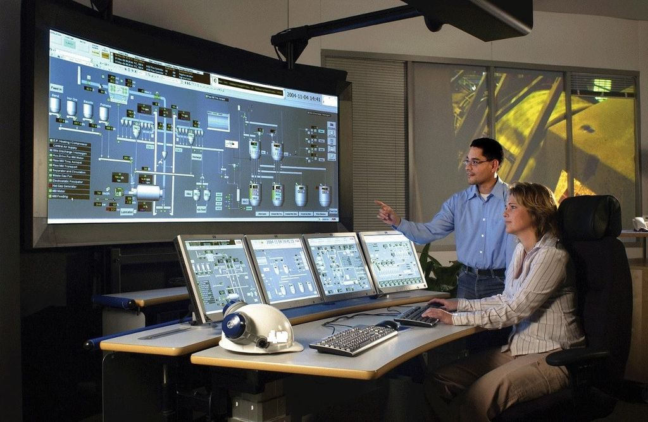
Accelerating Alternative Timing and Synchronization Modernization for the Grid
Test, evaluate, and document the capabilities and limitations of today’s technology for augmenting GPS timing in the grid
Perform R&D and provide technical assistance to federal and commercial partners to implement alternative timing & synchronization solutions
Design and test complementary timing/synchronization architectures that:
  Drive reliable and economical scaling to large geographic areas
  Easily integrate into existing technical environments to bolster resilience
  Use affordable COTS capabilities
  Ensure security and resistance to adversarial and natural disruptions

Slide 8
Motivation – The Need for HIL
Why HIL? To quantify the Error Chain.
Precision Under Stress: While software simulations assume "ideal" timing, a physical HIL platform captures the real-world stochastic nature of network jitter and hardware latency that simple models overlook.
Controllable & Repeatable Impairment Injection: Enables the injection of specific, quantified "timing impairments" in a safe, isolated environment.
Quantifying the Error Chain: HIL uniquely allows for measuring end-to-end propagation error.
Time Impairment
Time Distribution Error
PMU Sampling Error
Phasor Estimation Error
Control Maloperation

Slide 9
Evaluating Resilient Timing for Grid Services
Protocol Agnostic Testing: By focusing on "time impairments", the platform evaluates the unique error signatures of diverse synchronization sources—including GNSS, IRIG-B, PTP, and White Rabbit—quantifying their impact on grid stability regardless of the underlying transport layer.
Safety Margin Identification: HIL platform can identify the "threshold", where timing degradation leads to Control Maloperation.
Operational Readiness: Moving from theoretical resilience to hardware-validated resilience, ensuring new timing sources meet the IEC 60255.118.1 / IEEE C37.118.1 performance standards.
GNSS
IRIG-B
Time Impairment
Performance Compliance
PTP
White Rabbit

Slide 10
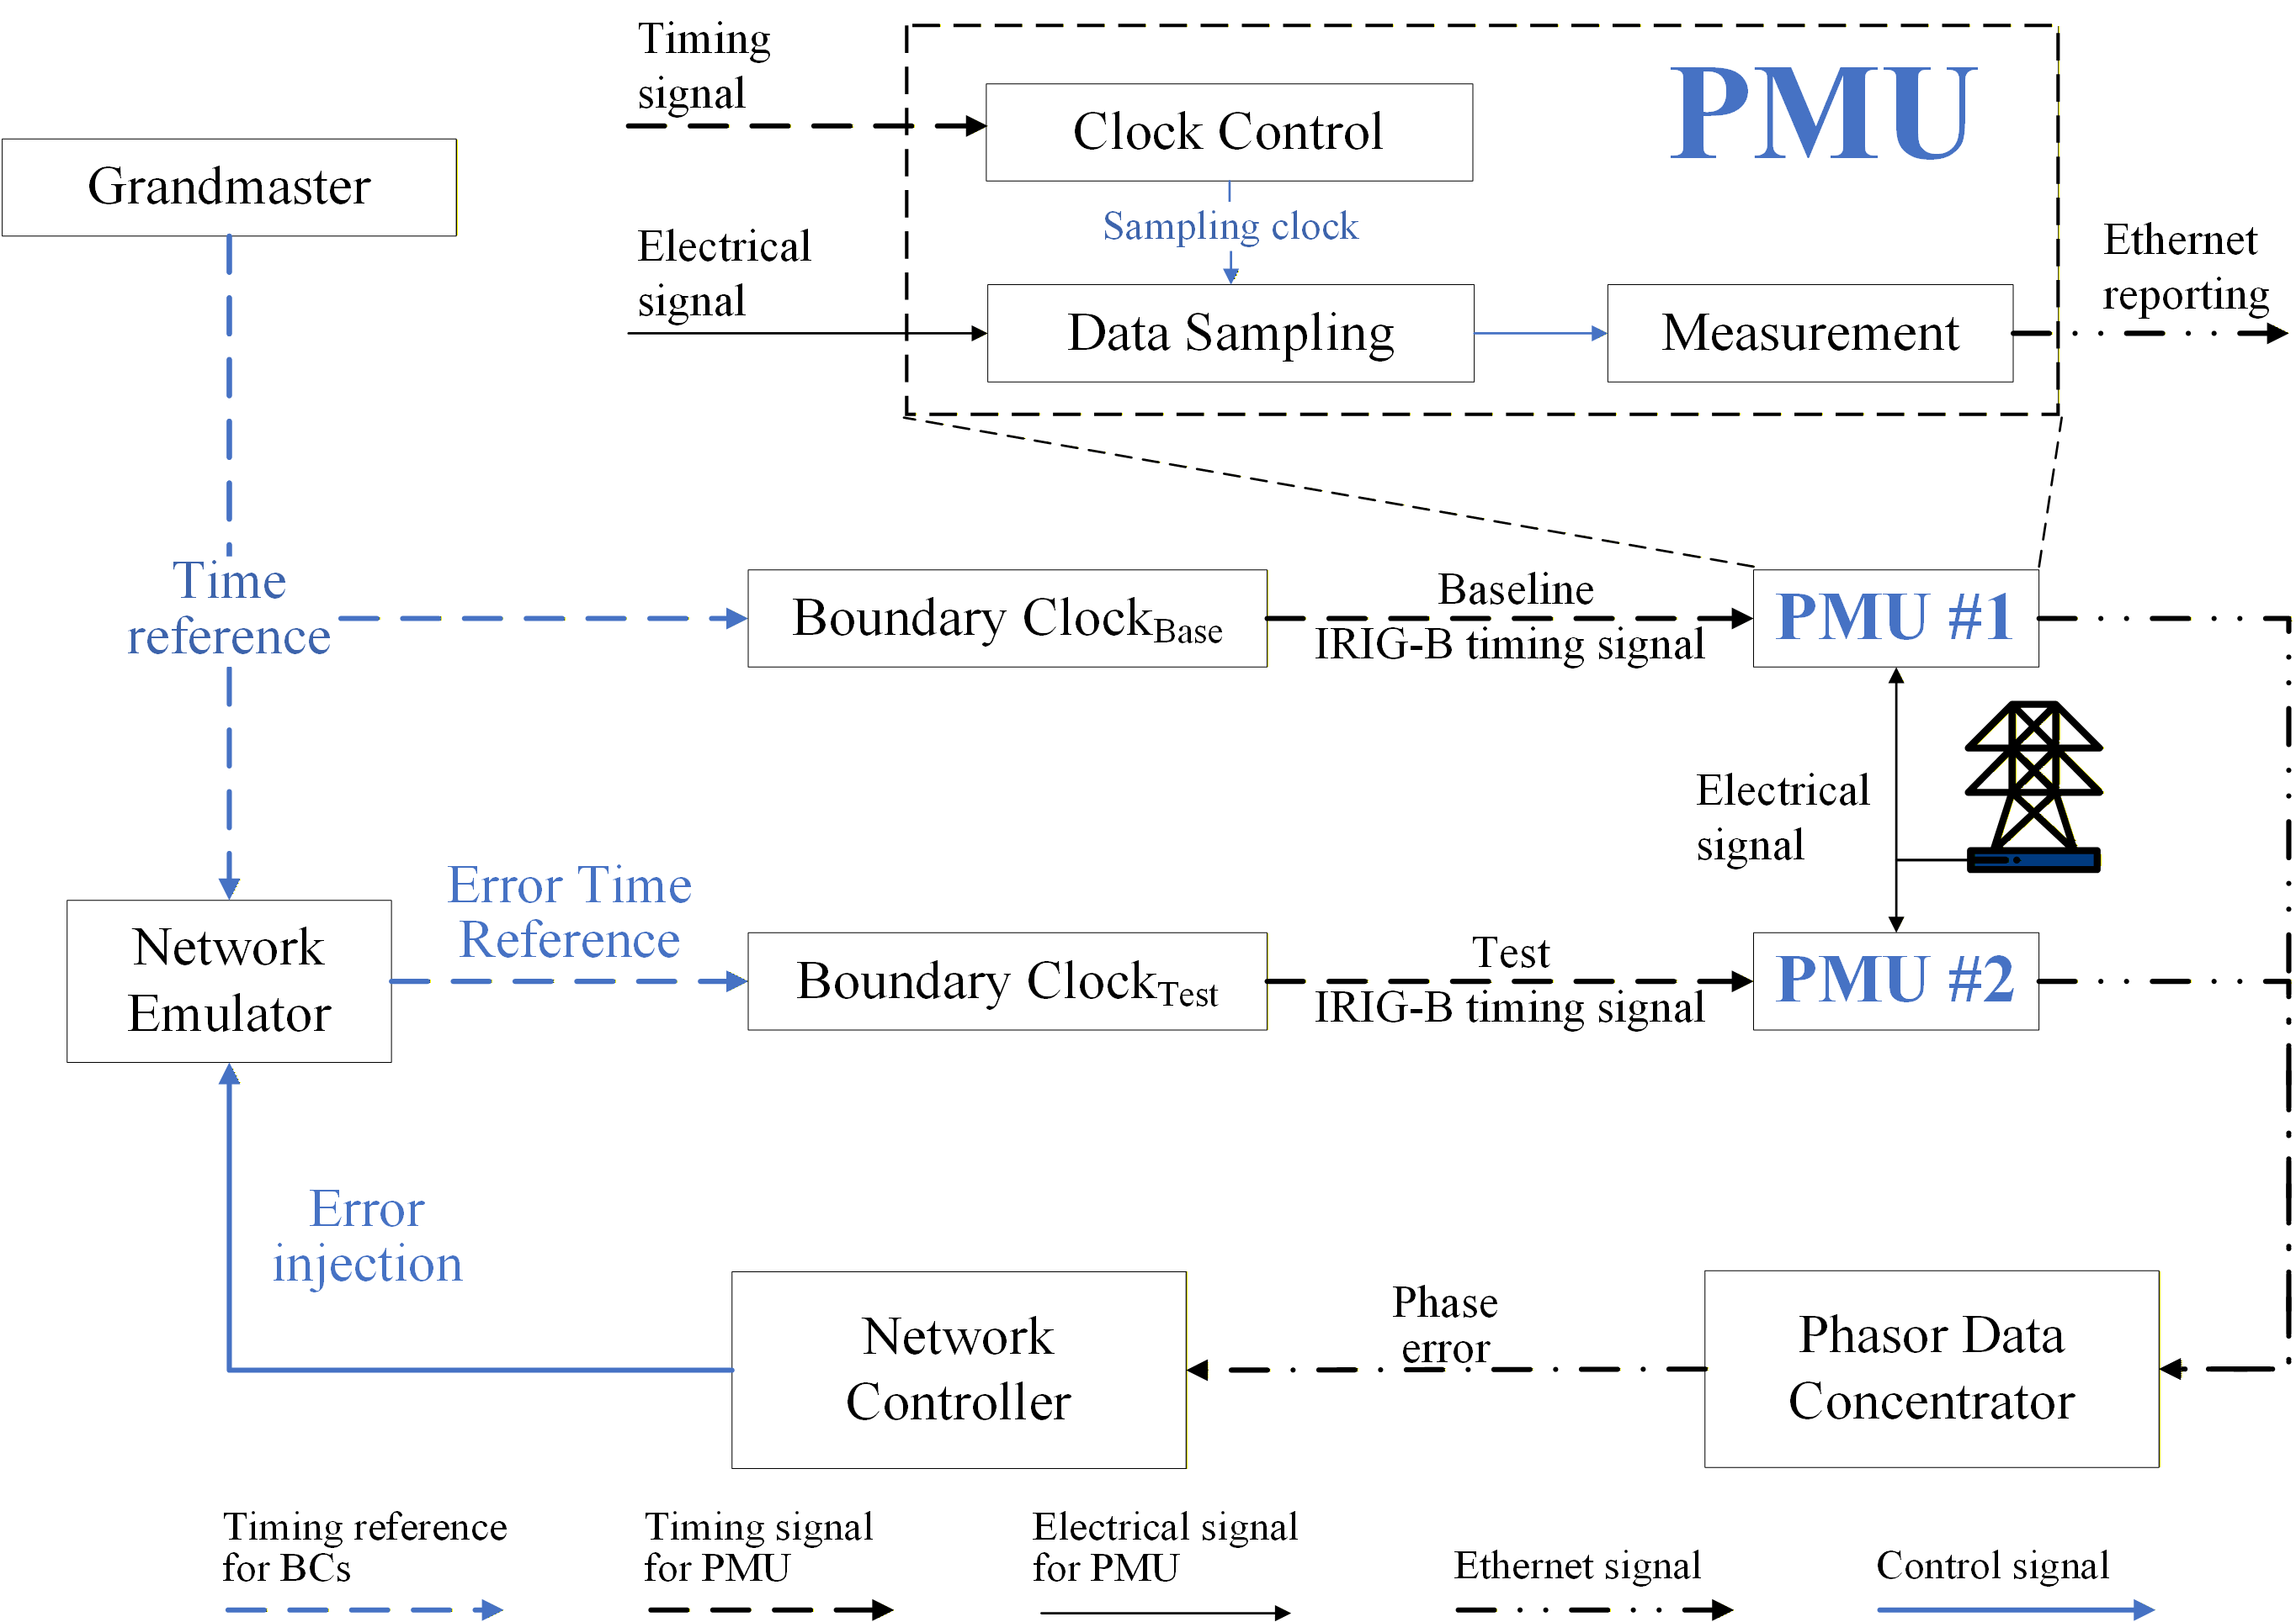
Architecture of Network Hardware-in-the-Loop Platform
Steady-state signal injection:
  Both PMUs receive the same 60 Hz steady-state signal to isolate timing-induced errors by eliminating power system transients.
Time reference & distribution:
  A UTC-aligned cesium atomic grandmaster distributes IEEE 1588 PTP to two boundary clocks (BCs).
  A dual-chain compares a clean Baseline Chain (PMU #1) against an Impaired Chain (PMU #2).
Time impairment injection:
  A network emulator injects controlled PTP timing errors, quantifying how timing impairments propagate into synchrophasor measurements.

Slide 11
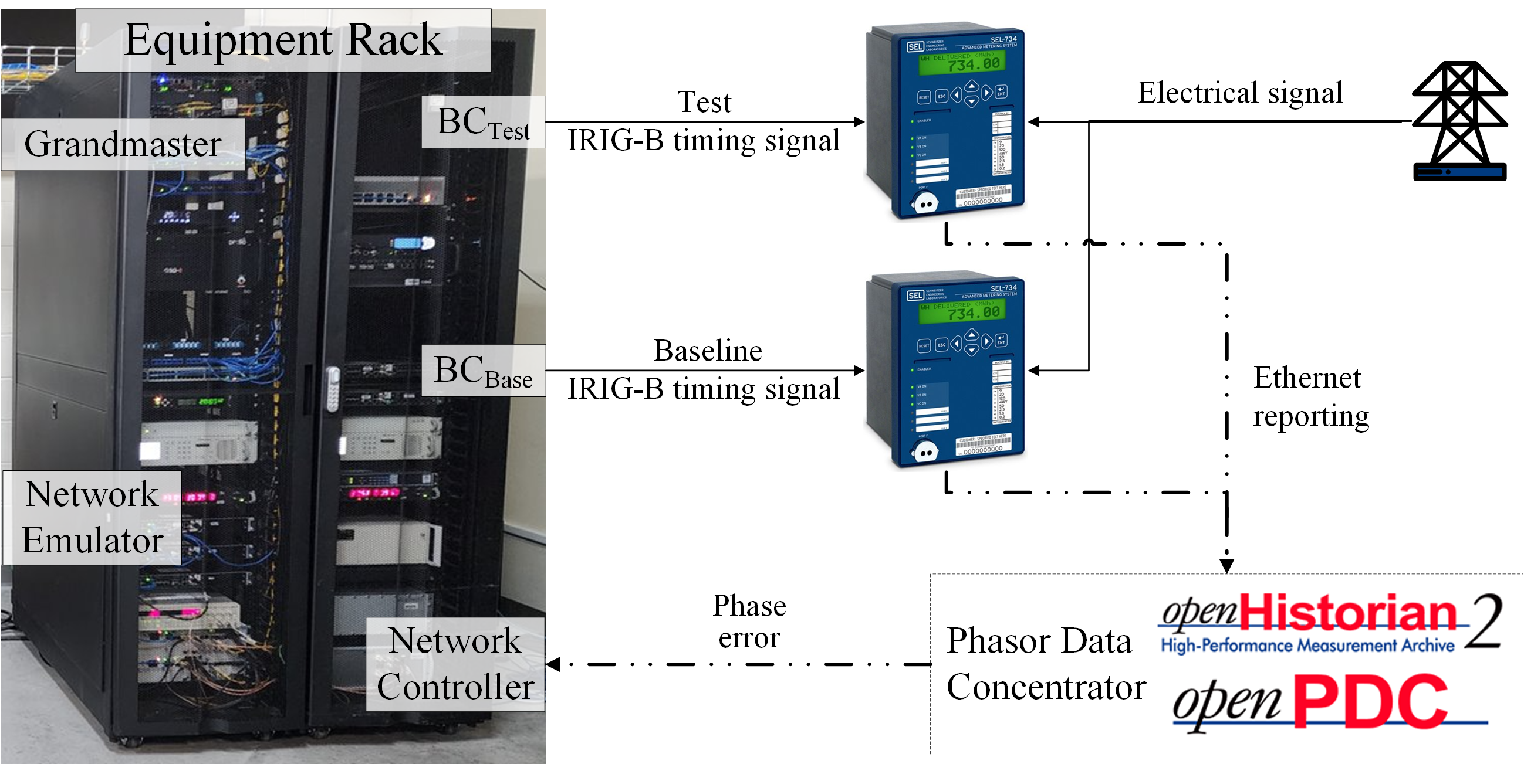
Architecture of Network Hardware-in-the-Loop Platform
Hardware Integration:
  A single equipment rack integrates the Cesium Grandmaster, Boundary Clocks, and the Netropy Network Emulator.
  Dual SEL-734 PMUs: Connected to respective chains; both monitor the same electrical signal.
Data Management & Feedback:
  OpenHistorian PDC: Aggregates Ethernet-based PMU reports for real-time analysis.
  Closed-Loop Control: Calculated Phase Angle Error (PAE) is fed back to the network controller.

Slide 12
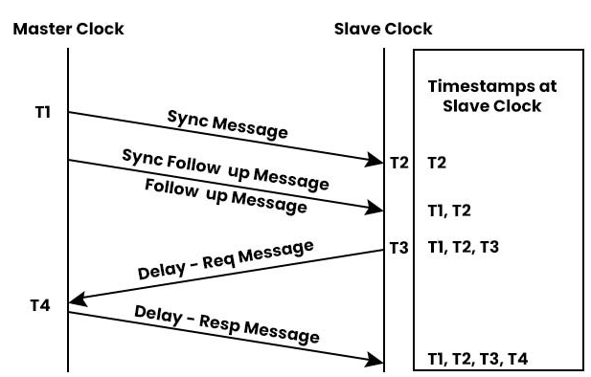
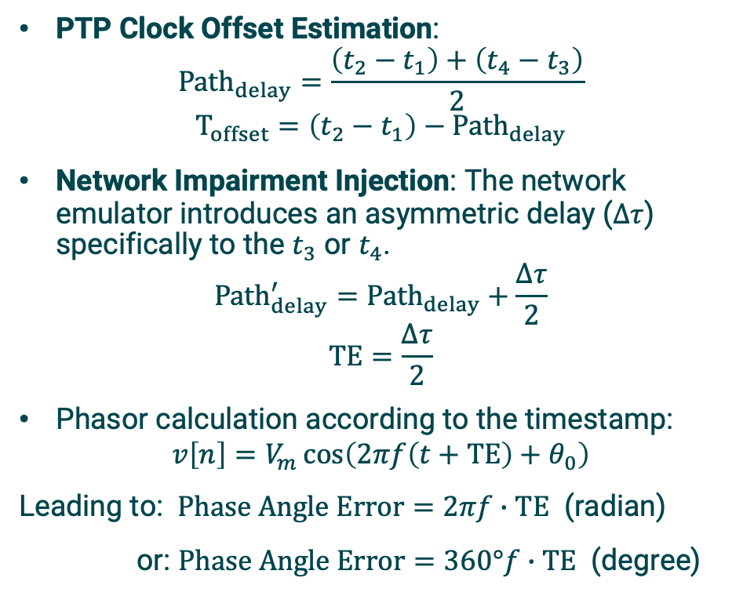
Time Error Analysis: From PTP Packets to Phasor Measurements
PTP Clock Offset Estimation:
$${Path}_{delay}=\frac{\left(t_{2}−t_{1}\right)+\left(t_{4}−t_{3}\right)}{2}$$
$$T_{offset}=\left(t_{2}−t_{1}\right)−{Path}_{delay}$$
Network Impairment Injection: The network emulator introduces an asymmetric delay ($∆τ$) specifically to the $t_{3}$ or $t_{4}$.
$${Path}_{delay}^{′}={Path}_{delay}+\frac{∆τ}{2}$$
$$TE=\frac{∆τ}{2}$$
Phasor calculation according to the timestamp:
$$v\left[n\right]=V_{m}\cos\left(2πf\left(t+TE\right)+θ_{0}\right)$$
Leading to: $Phase Angle Error=2πf∙TE$ (radian)
or: $Phase Angle Error=360°f∙TE$ (degree)

Slide 13
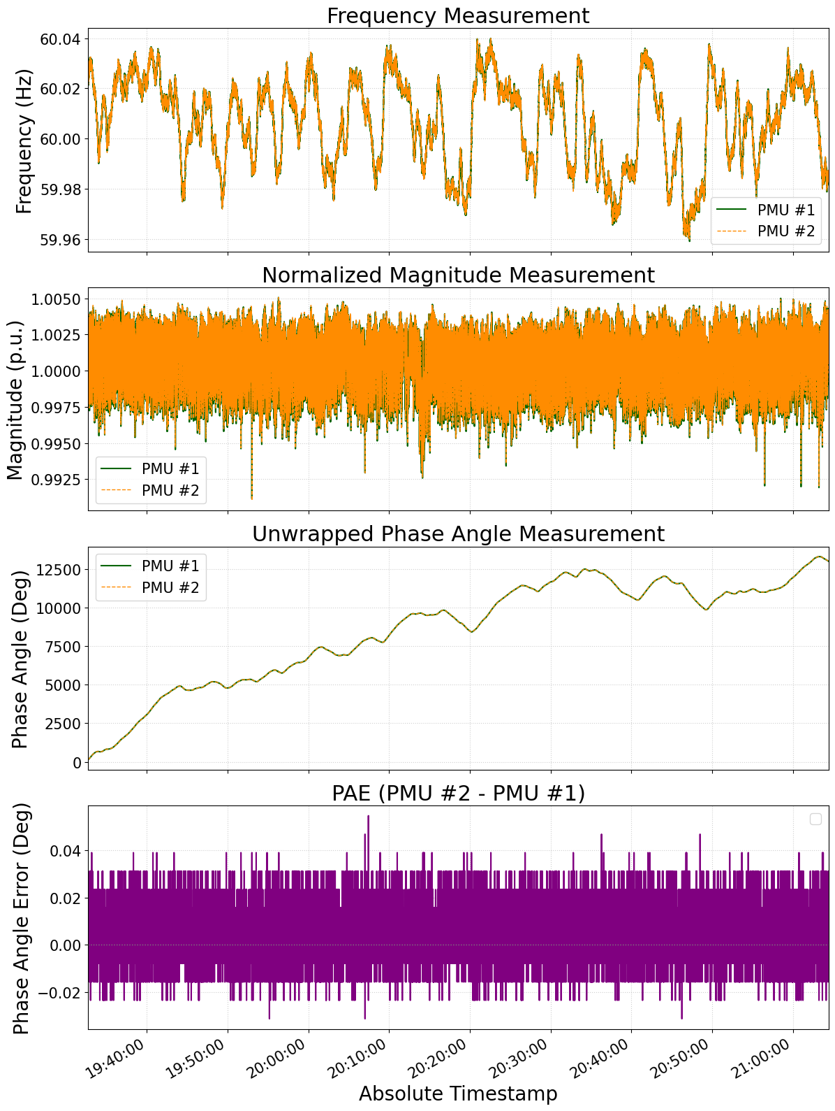
Time Error Analysis:
Experimental Results
Experimental setup:
  Baseline test: No network impairment is injected.
    With the identical 60Hz electrical signal feeding, the steady-state performance of the platform is tested.
    Synchrophasors from two PMUs are well aligned.
      PAE with in ±0.04 degree (Below IEEE C37.118.1 requirement about the steady-state).
    Time Error greater than 1 us will be detectable.
PMU measurements during steady-state
(20 frames per sec)

Slide 14
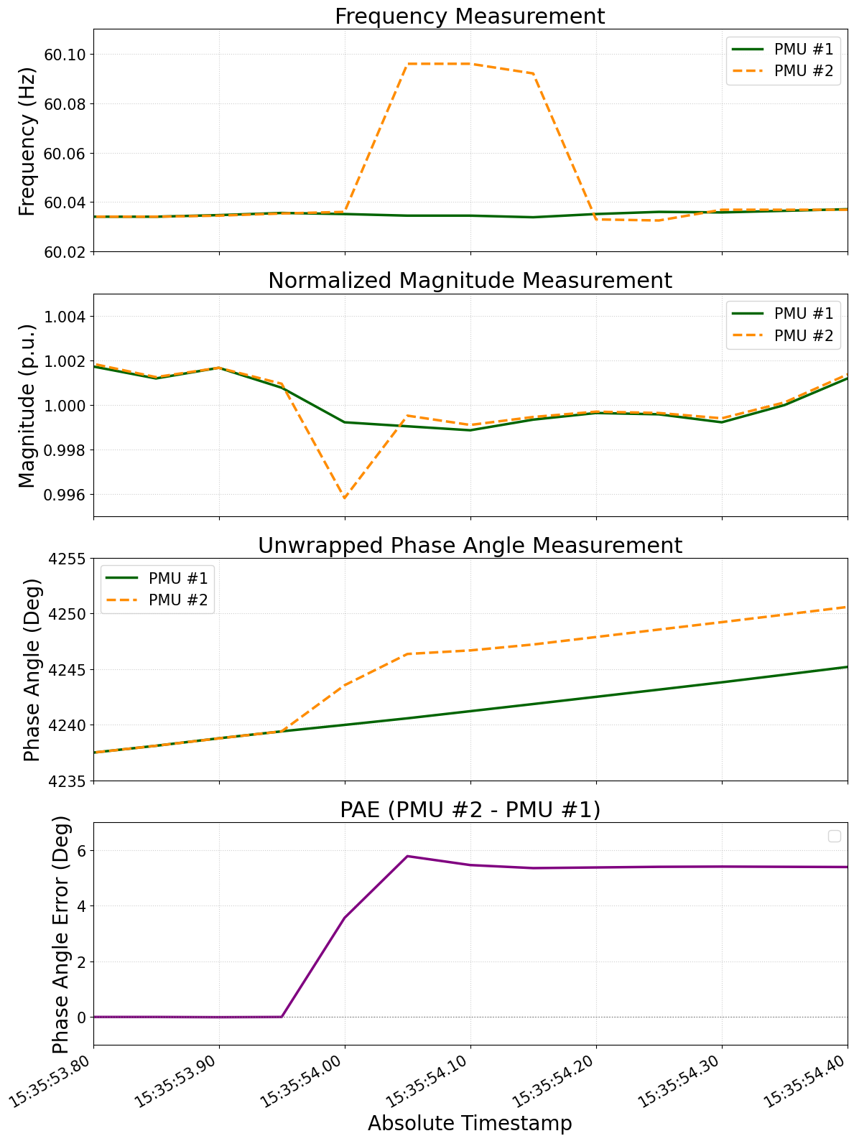
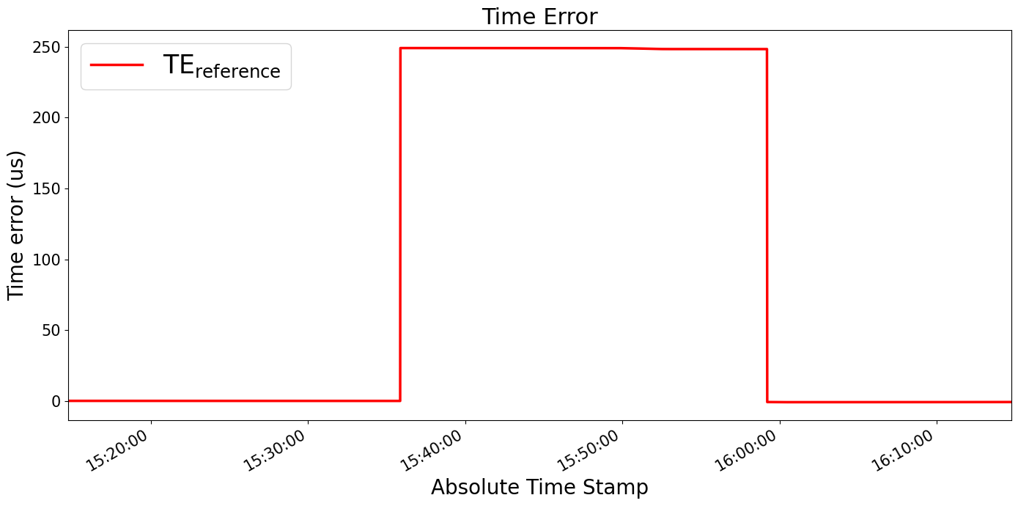
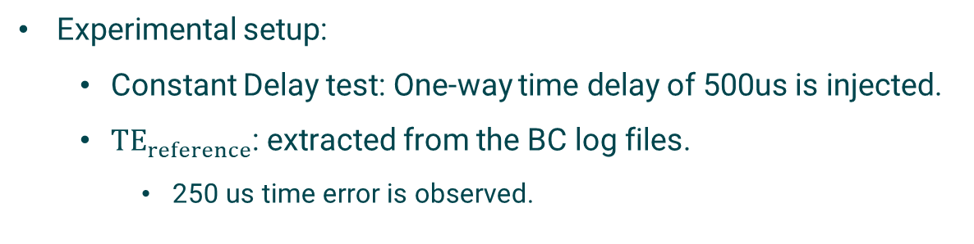
Time Error Analysis:
Experimental Results
Experimental setup:
  Constant Delay test: One-way time delay of 500us is injected.
  ${TE}_{reference}$: extracted from the BC log files.
    250 us time error is observed.
NE injects
time delay
NE stops
time delay
PMU measurements during transit
(20 frames per sec)

Slide 15
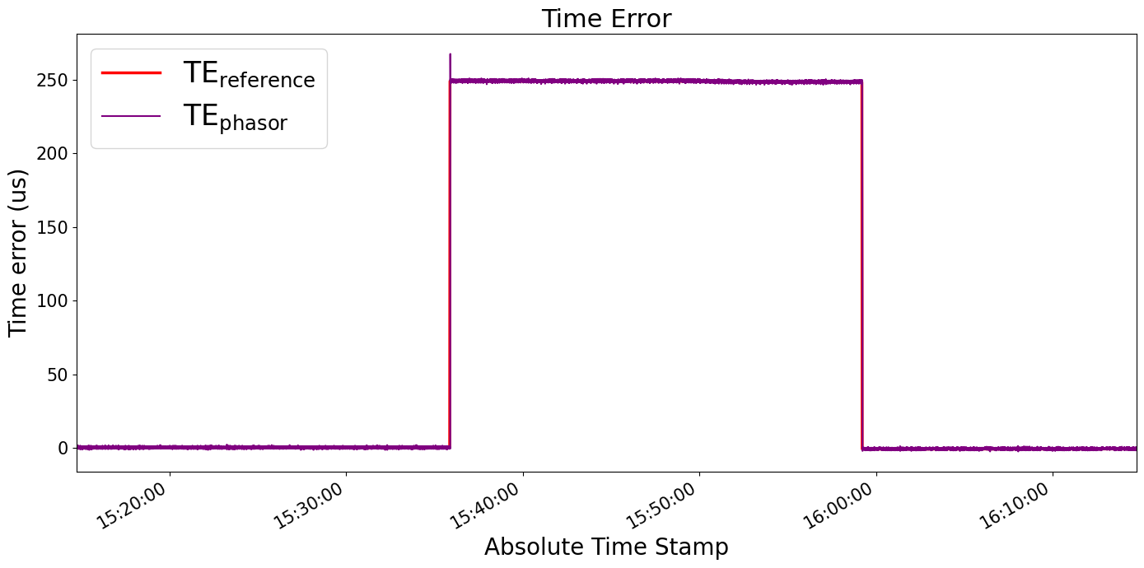
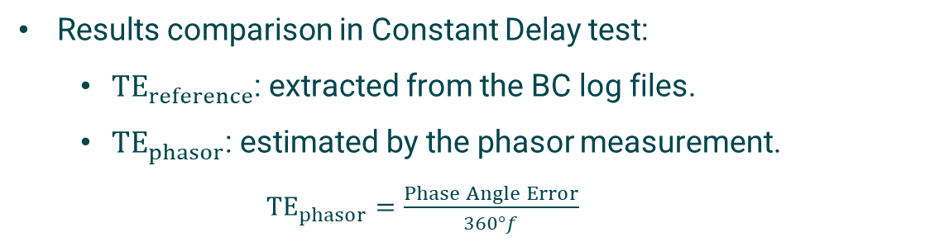
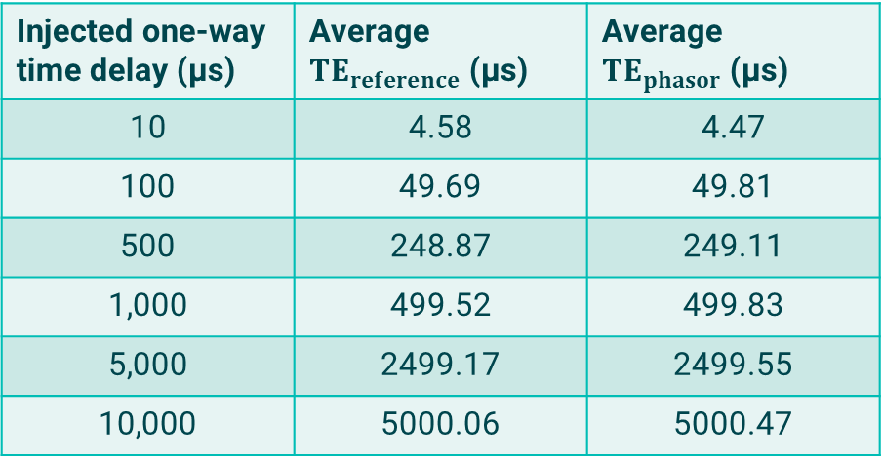
Time Error Analysis:
Experimental Results
Injected one-way time delay (µs) | Average ${TE}_{reference}$ (µs) | Average ${TE}_{phasor}$ (µs)
10 | 4.58 | 4.47
100 | 49.69 | 49.81
500 | 248.87 | 249.11
1,000 | 499.52 | 499.83
5,000 | 2499.17 | 2499.55
10,000 | 5000.06 | 5000.47
Results comparison in Constant Delay test:
  ${TE}_{reference}$: extracted from the BC log files.
  ${TE}_{phasor}$: estimated by the phasor measurement.
      ${TE}_{phasor}=\frac{Phase Angle Error}{360°f}$
NE injects
time delay
NE stops
time delay

Slide 16
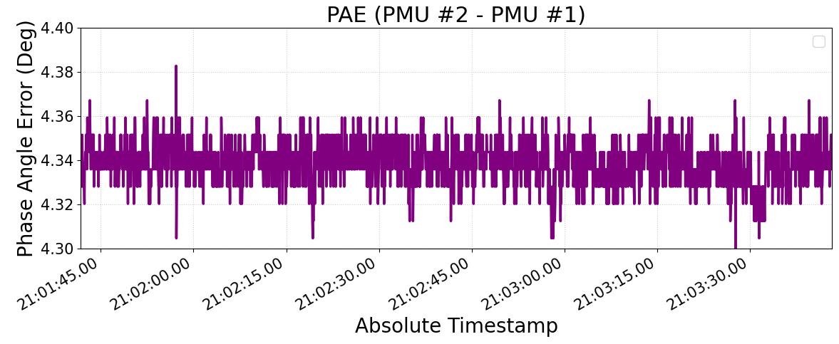
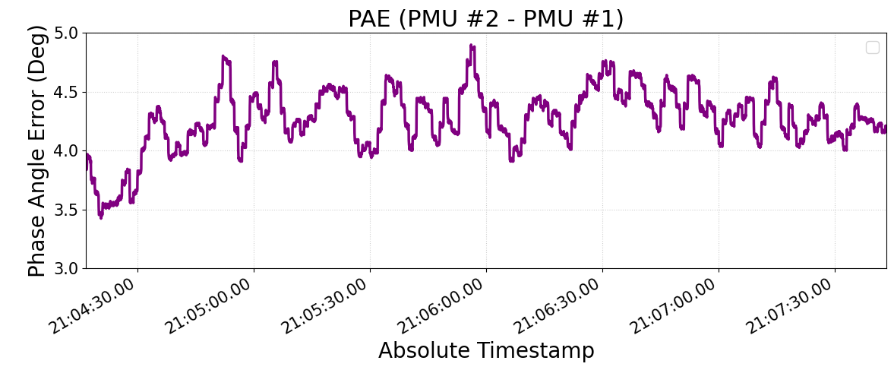
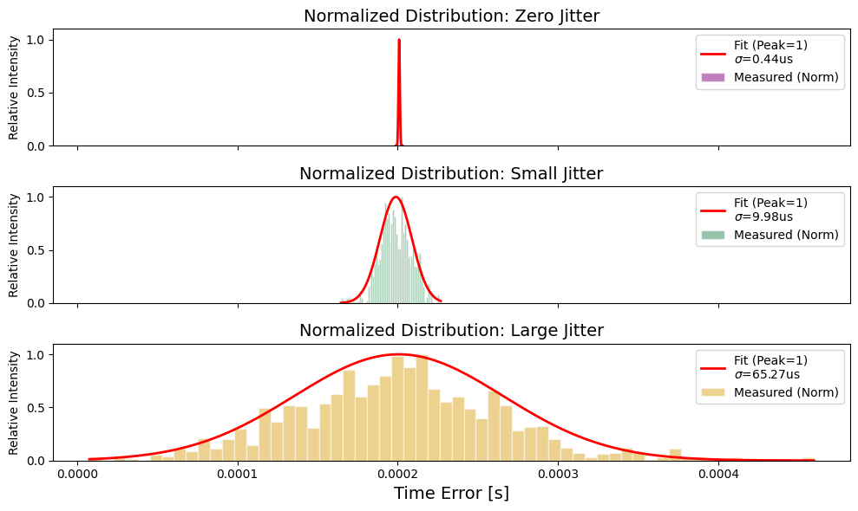
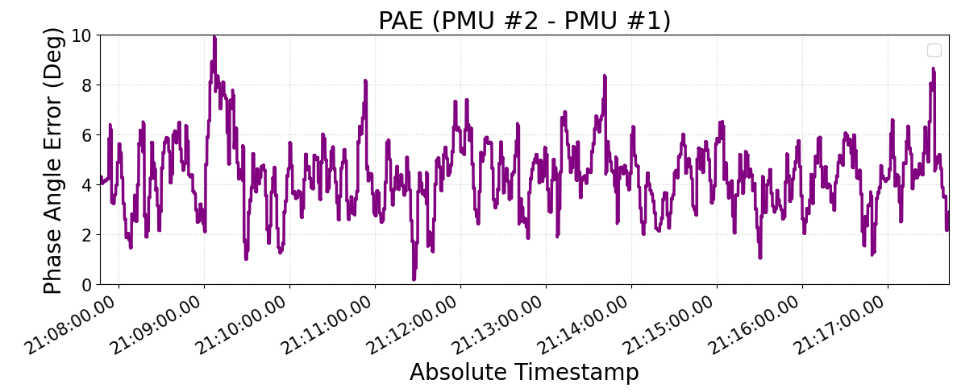
Time Error Analysis:
Experimental Results
Zero jitter
Experimental setup:
  Jitter test: Three different scales of jitters are injected.
    The jitter scale is corresponding to the PAE scale.
Small jitter
Large jitter
Time error
conversion

Slide 17
HIL Integration with Real-Time Simulator
We are currently integrating the network HIL with a real-time power system simulator to investigate the impact on various grid services.

Slide 18
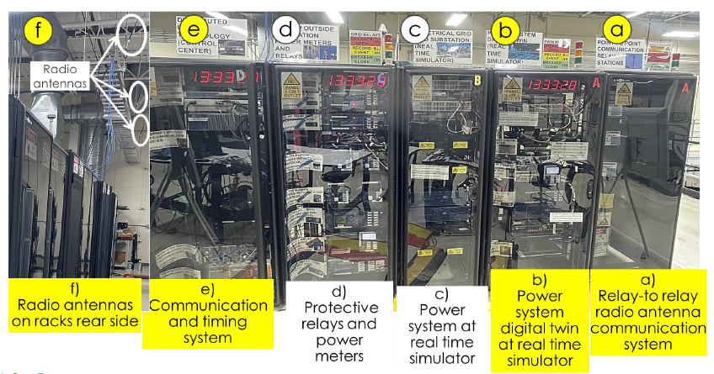
Ongoing Experiment: Fully HIL Testing

Slide 19
Summary and Conclusion
This study demonstrated the high-fidelity capabilities of an NHIL testbed for evaluating PMU performance under communication timing impairments.
Baseline experiments verified that the PMUs operated well within the IEEE C37.118.1 accuracy requirements.
Under faulted conditions, the NHIL environment enabled precise injection of network delays ranging from 10 micro-sec to 10 milli-sec, revealing a clear and repeatable correlation between cyber-side delay and synchrophasor measurement error.
The time error estimated from the phasor data precisely matched both theoretical predictions and ground-truth IRIG-B measurements. This validation confirms the NHIL platform’s ability to accurately translate cyber-side network anomalies into physically observable measurement degradation.
Such measurement degradation can severely compromise grid situational awareness, leading to erroneous state estimation and false tripping of differential protection relays.
Ensuring the immunity of synchronization protocols against network latency is not merely a compliance issue, but a fundamental requirement for preventing cascading failures in increasingly automated systems.
Future work focuses on integrating this platform into a full HIL configuration with a real-time power system simulator to evaluate closed-loop control applications.
Notes:
NMEA

Slide 20
Information, Collaboration, and Technical Resources
Contact CAST@ornl.gov
  Technical assistance and collaboration opportunities
  Equipment and network requirements
  Timing/synchronization performance monitoring capabilities
CAST Website: https://cast.ornl.gov
  Access our technical resources and bulletins, live timing data, news items, and conference activities

Slide 21
Questions?

