Slide 1
OpenSAMPL – Timing Measurement and Assurance
June 1-4, 2026 | IEEE SGSMA Santiago, Chile
Joshua N. Grant
ORNL
Notes:
This work addresses a fundamental but under-observed problem in power systems: time trust.

Slide 2
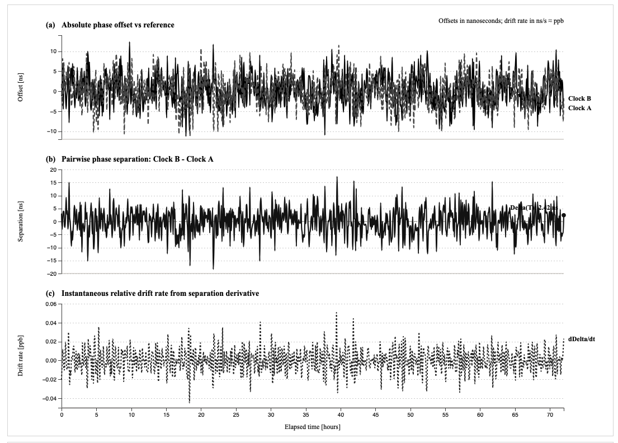
Motivation: Why Time Matters
Time is Critical Infrastructure
Grid operations depend on precise, shared time
Microseconds can determine:
  Stability vs failure
  Accurate vs misleading measurements
Synchronization underpins:
  PMUs
  Protection systems
  Event reconstruction
Notes:
Emphasize that time is not just a parameter—it is a dependency layer for everything else

Slide 3
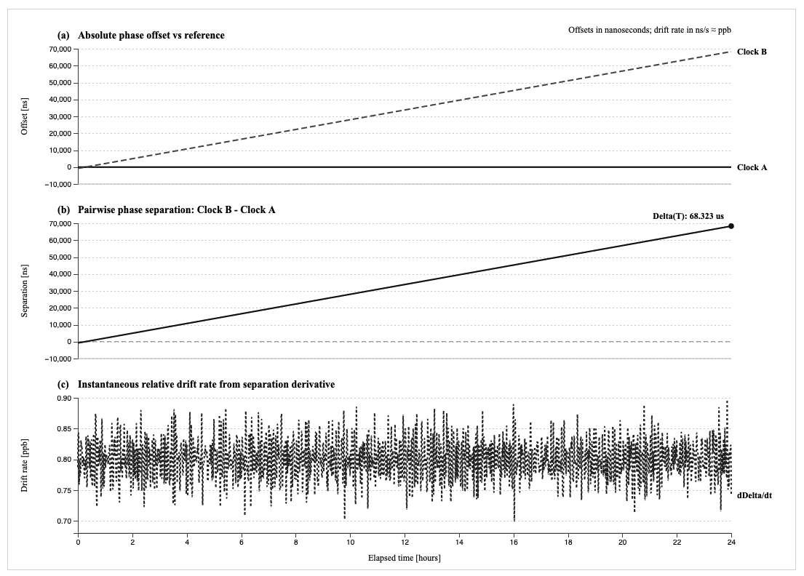
Fundamental Concept: Clocks are Imperfect
Clocks Always Drift
Every clock has
  Drift (frequency error)
  Offset (time error)
Even synchronized clocks diverge without correction
Influenced by:
  Temperature
  Hardware aging
  Network conditions
Notes:
Sets up inevitability of error → need for monitoring

Slide 4
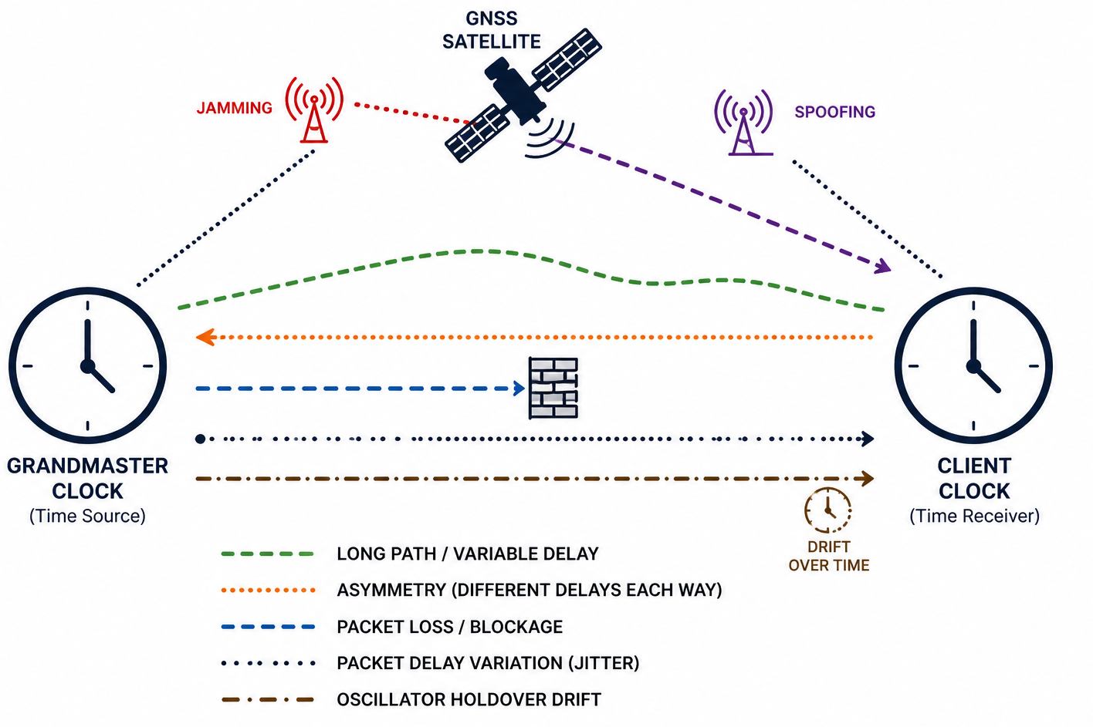
The Real-World Problem
Modern Timing Systems Are Fragile
GNSS dependency is vulnerable:
  Jamming
  Spoofing
Networking timing (PTP):
  Packet delay variation
  Asymmetry
Oscillator holdover drift can accumulate quickly
Notes:
Emphasize: systems are precise but brittle

Slide 5
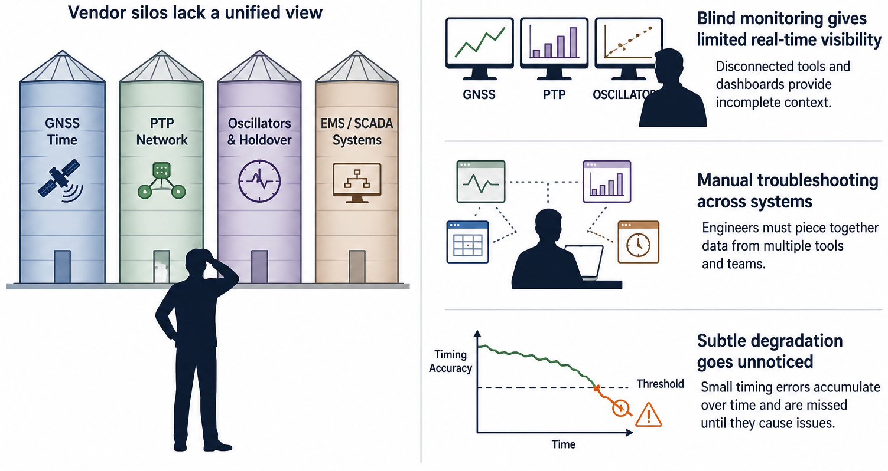
Operational Challenges
Notes:
This slide transitions from physics to operations

Slide 6
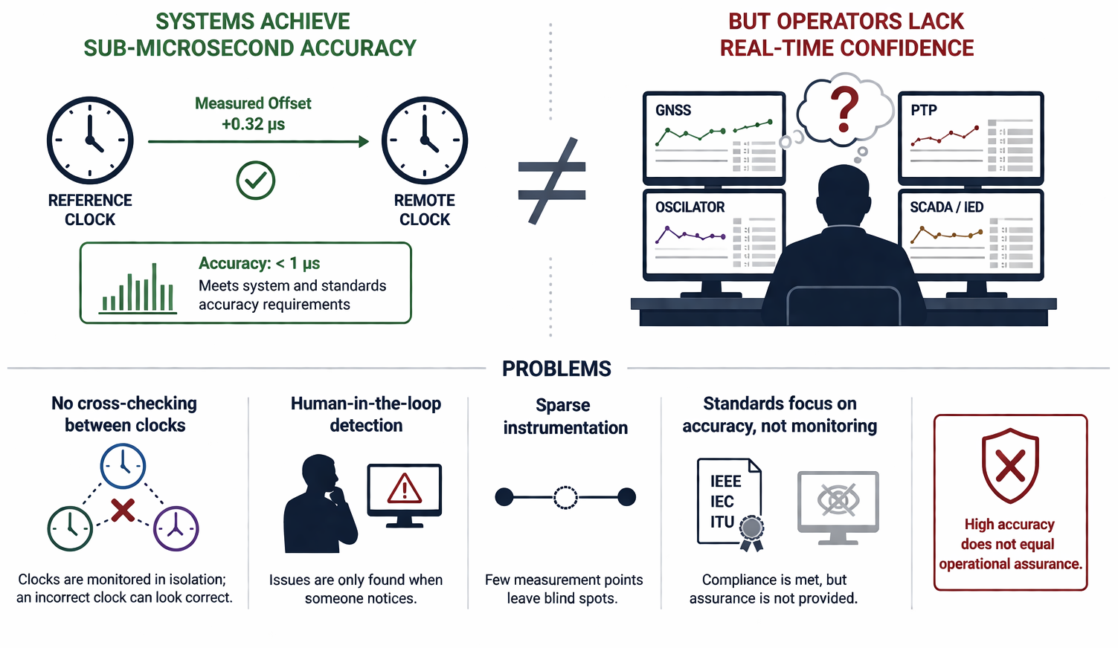
Accuracy ≠ Assurance

Slide 7
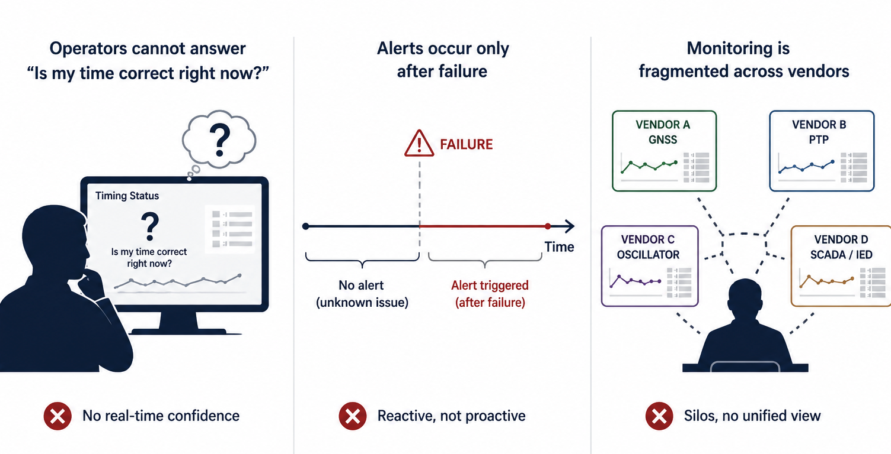
The Gap: No Continuous Timing Assurance

Slide 8

Introducing OpenSAMPL
Open-source Python framework
Unified platform for:
  Ingesting timing data
  Analyzing synchronization
  Visualizing system health
Vendor agnostic
Notes:
OpenSAMPL provides observability for time.

Slide 9
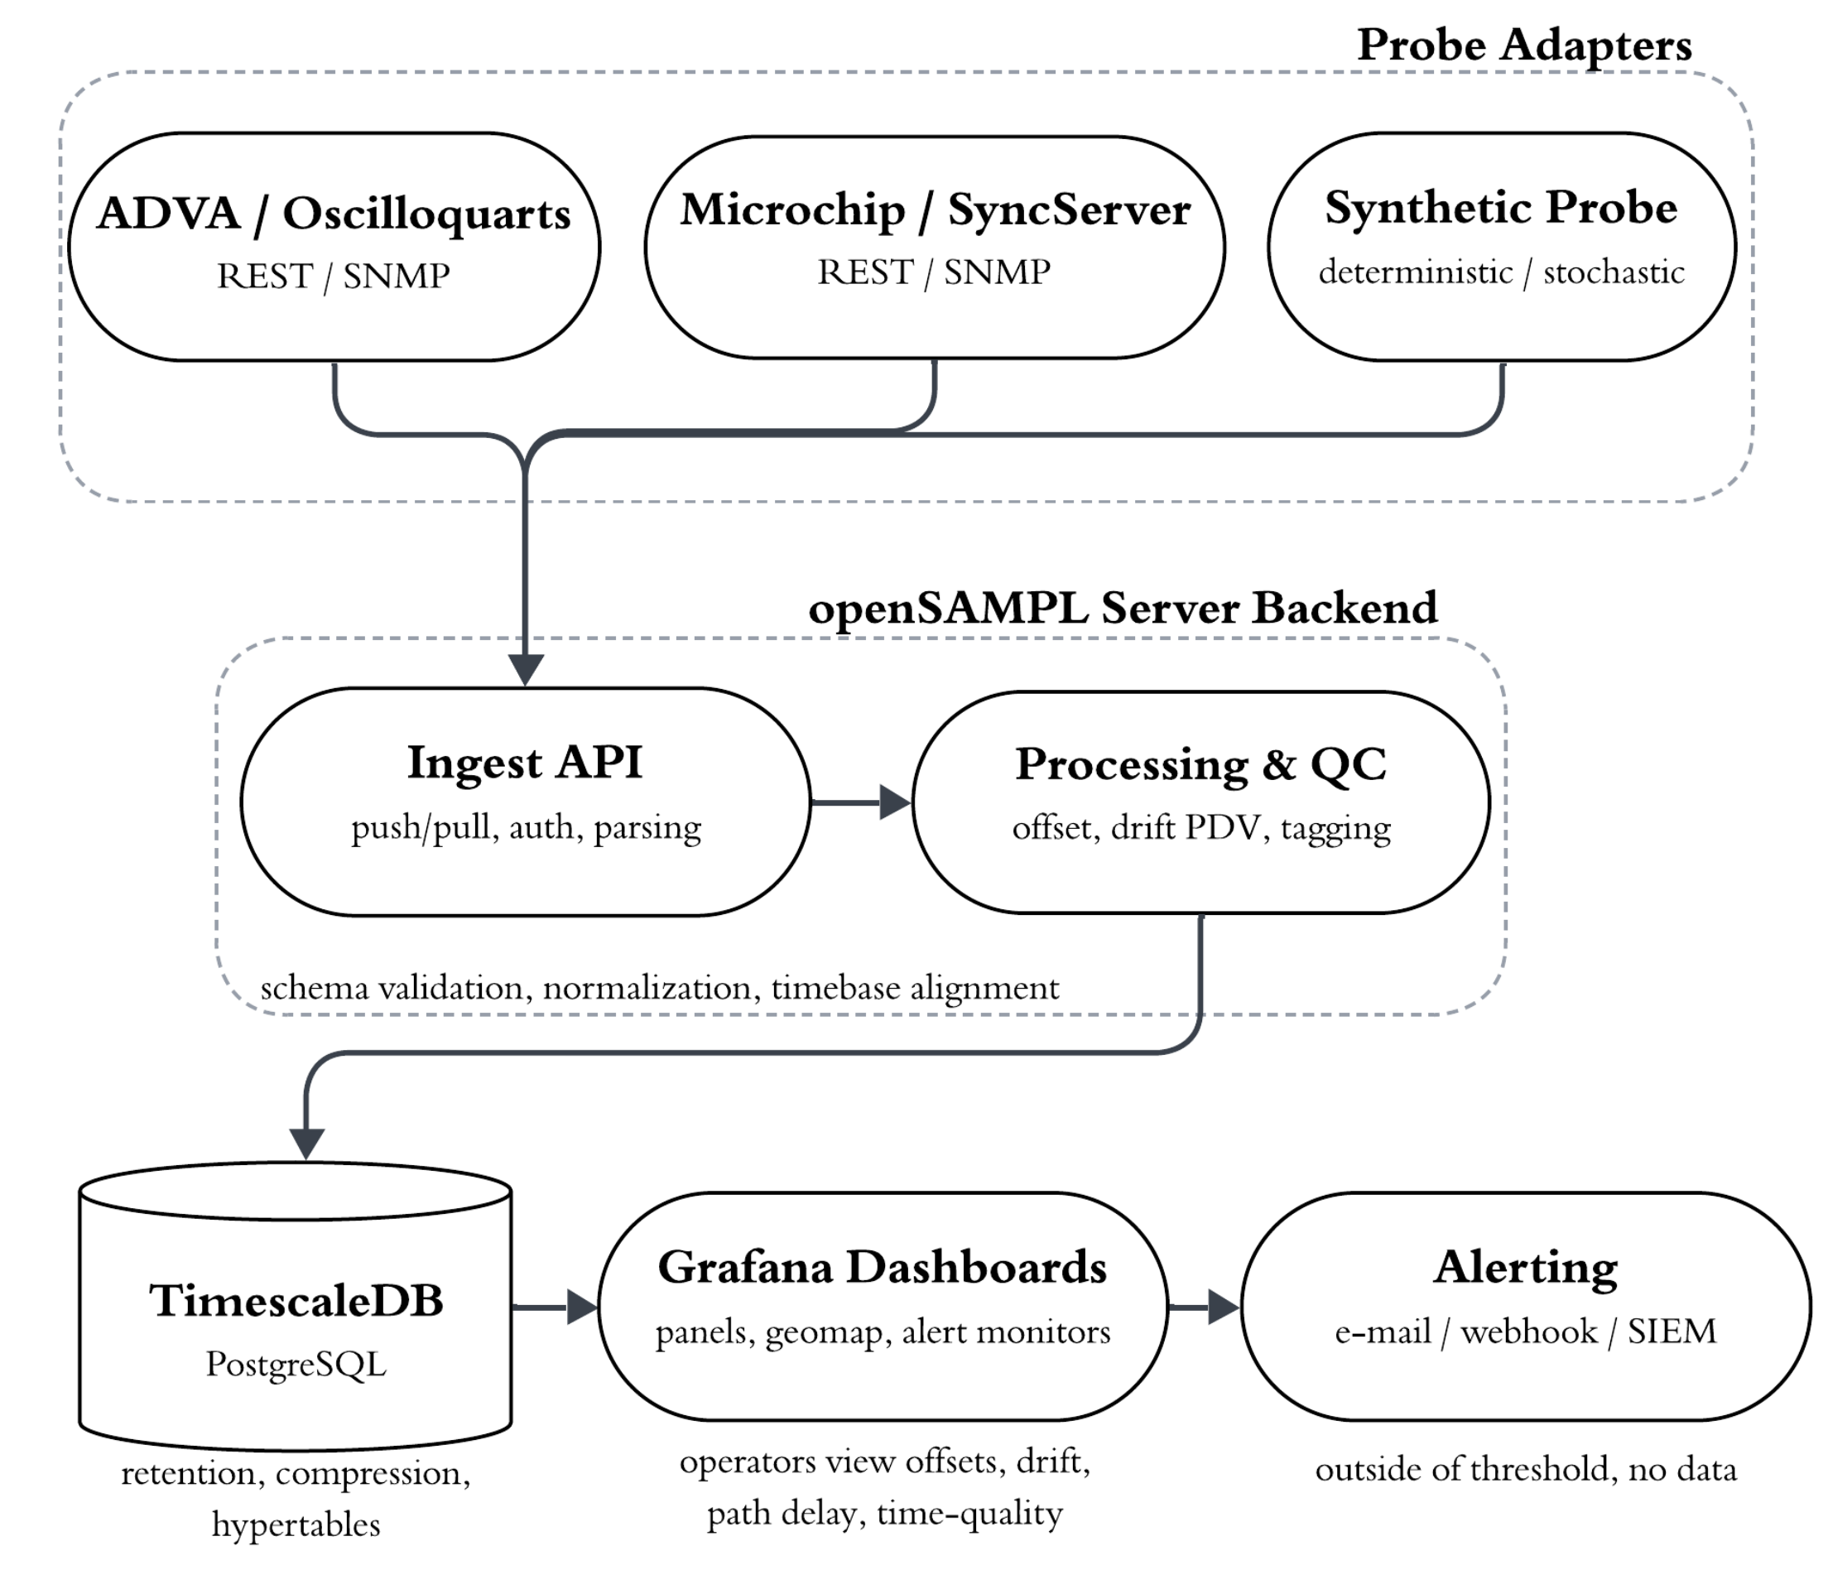
OpenSAMPL Architecture

Slide 10
Standardized Data Ingestion
PTP
Oscillator
NTP
Standardized Data Format
Customizable Near Real-Time Data Collection
Supports
  GNSS clocks
  PTP devices
Interfaces:
  APIs
  SNMP
  File Ingestion
Extensible via plugins

Slide 11
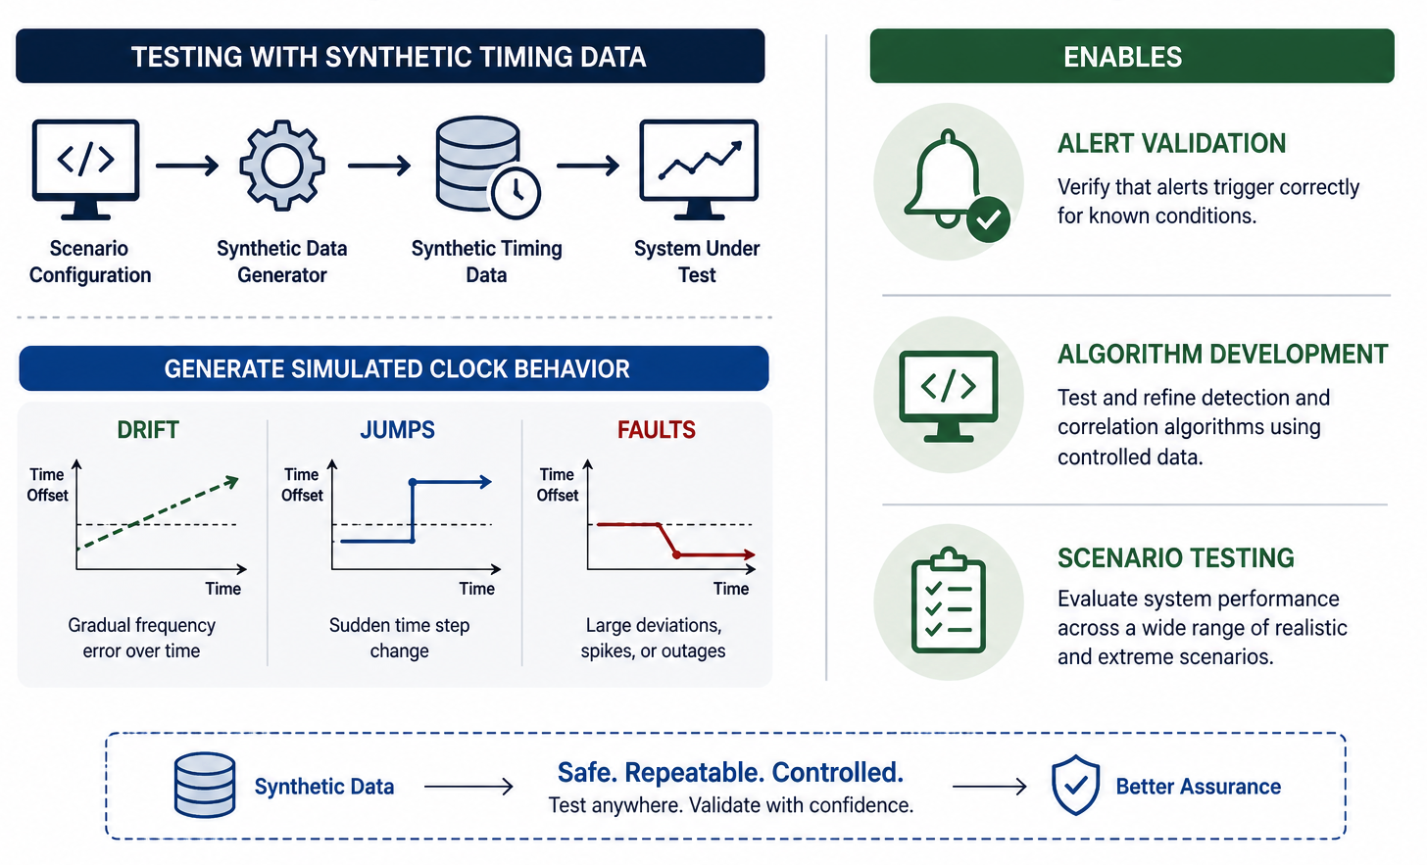
Synthetic Data Capability

Slide 12
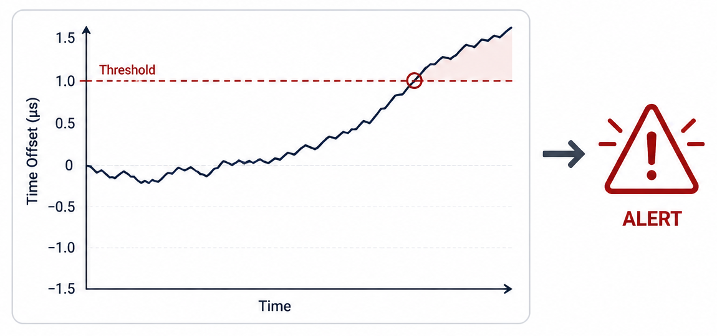
Analytics & Alerting
Time Anomaly Detection
Powered by Grafana
Detect:
  Offset thresholds
  Drift rates
  Cross-device divergence
Continuous monitoring of:
  Clock health
  Synchronization integrity

Slide 13
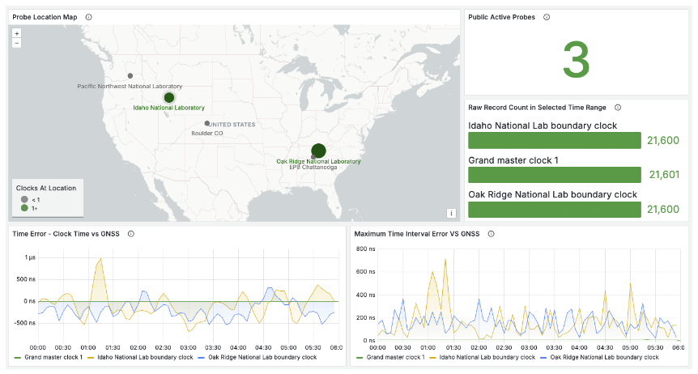
Visualization & Situational Awareness
Time-series plots
Geospatial mapping of clocks
Real-time alerts

Slide 14
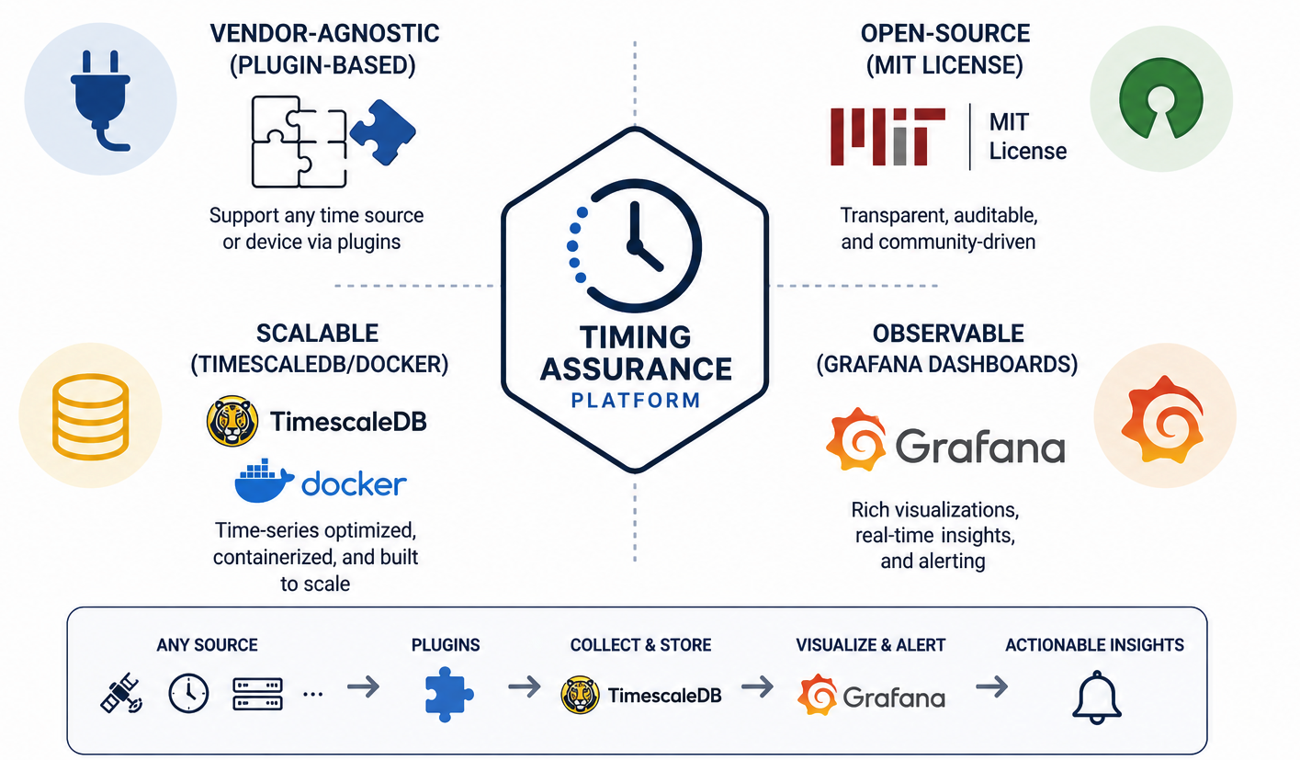
Key Design Principles

Slide 15
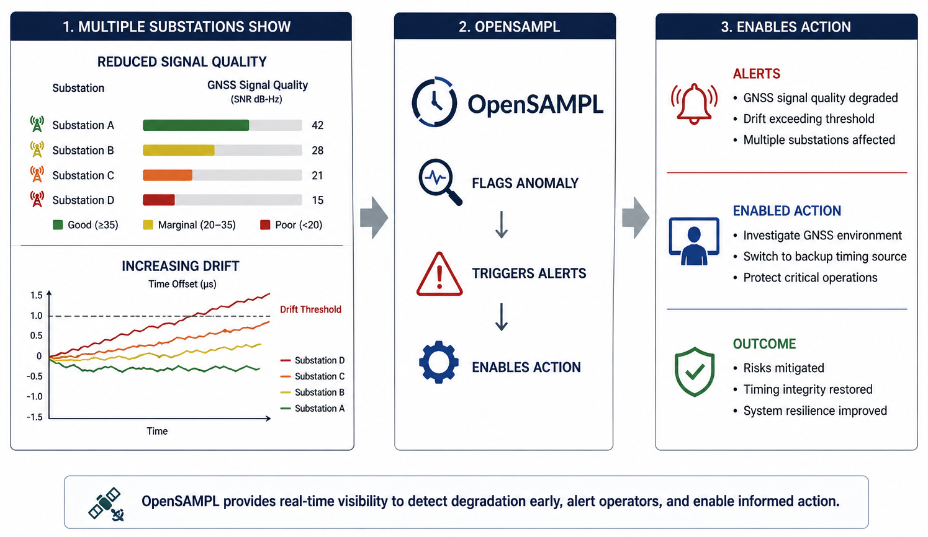
Example Scenario
Example: Detecting GNSS Degradation
Multiple substations show:
  Reduced signal quality
  Increasing drift
OpenSAMPL:
  Flags anomaly
  Triggers alerts
  Enables action

Slide 16
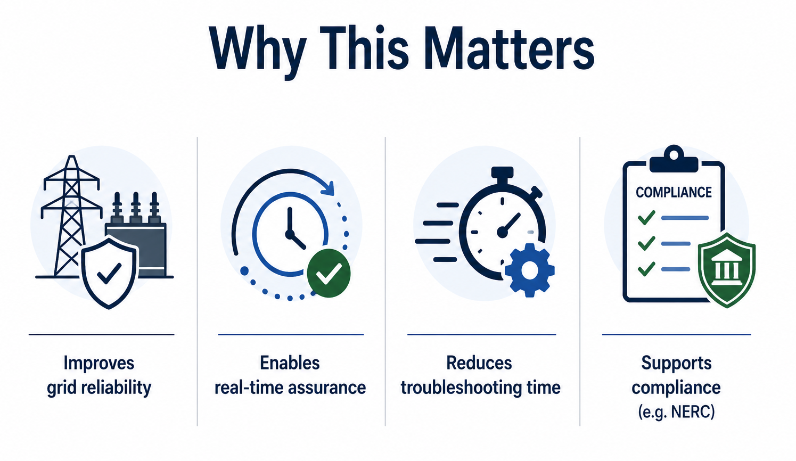
Impact

Slide 17
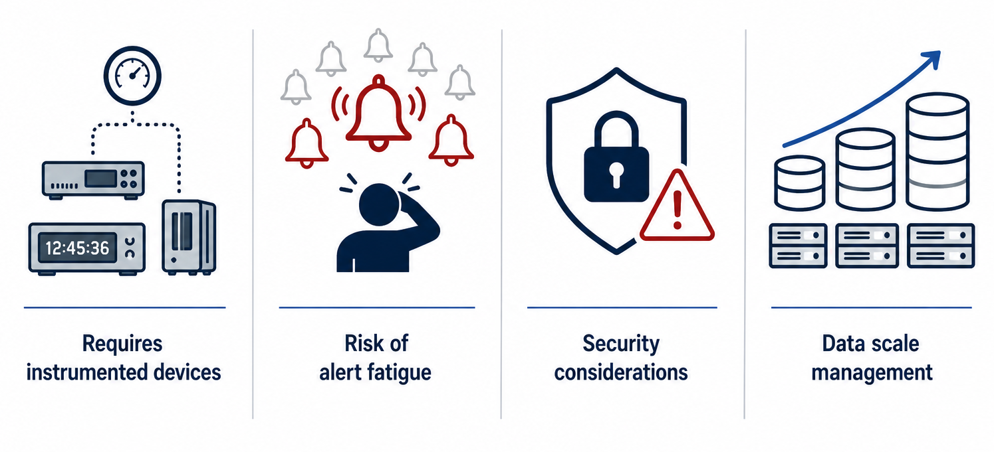
Limitations & Challenges

Slide 18
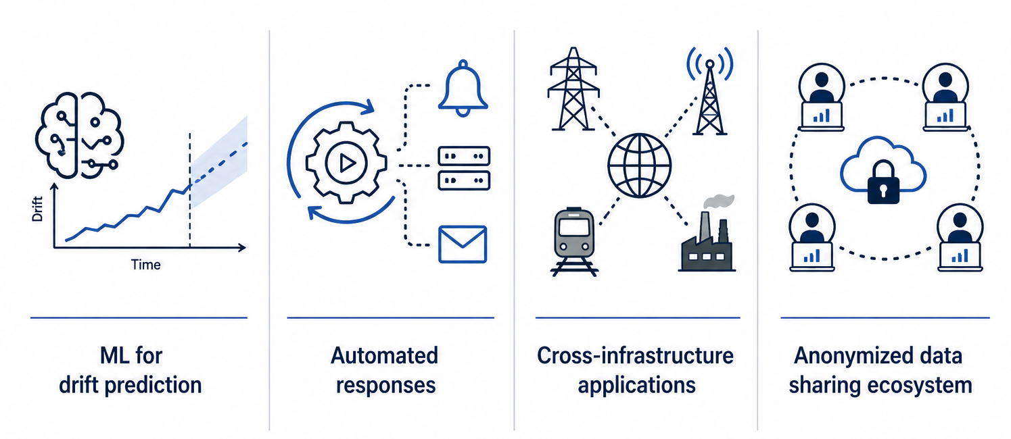
Future Work and Directions

Slide 19
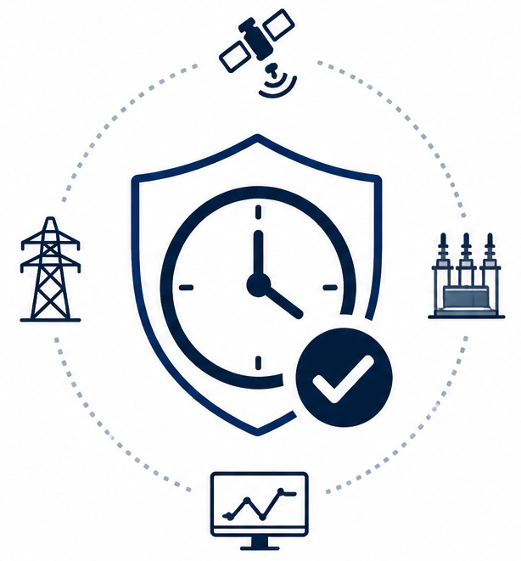
Conclusion
Timing is mission-critical
Accuracy alone is insufficient
OpenSAMPL enables:
  Observability
  Assurance
  Action
https://github.com/ORNL/OpenSAMPL
https://pypi.org/project/opensampl/
https://ornl.github.io/OpenSAMPL/

