Slide 1
Comparison of Two-Way Satellite Time and Frequency Transfer (TWSTFT) and PTP over long Distances
September 22, 2025
Presented by:
Amir Osman
Chris Cooper

Slide 2
Center for Alternative Synchronization and Timing (CAST)
Integrated Test Bed for Complementary Synchronization Solutions
National Security & Modernization Imperative
One-of-a-Kind Testbed with Dozens of Partnerships
Established Capacity for Transition to Utilities
GPS is vulnerable to spoofing and other cyber threats
Executive Order 13905 (2020): National Resilience through PNT
Alternative timing necessary for a modern grid
Commercial first
Assessing and validating against strict grid requirements
Partnerships to improve, refine, and adapt OEM capabilities
CRADA with NIST
Test and validate in real-world utility environments
Partnerships with NIST, multiple national labs, multiple PMAs, multiple utilities
Documenting and publishing best practices

Slide 3

CAST: Enabling Grid Resilience through Timing & Synchronization
Perform R&D and provide technical assistance on the implementation of alternative timing solutions
Test, evaluate, and document the capabilities and limitations of today’s technology for augmenting GPS time
Design and test resilient timing architectures that:
Use COTS capabilities
Easily integrate into existing technical environments (federal, utility)
Drive reliable and economical scaling to large geographic areas
Ensure security and resistance to cyber intrusion

Slide 4
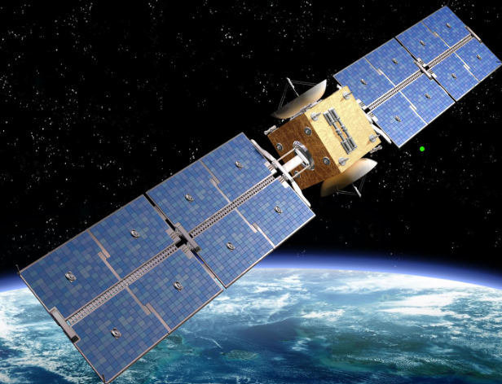
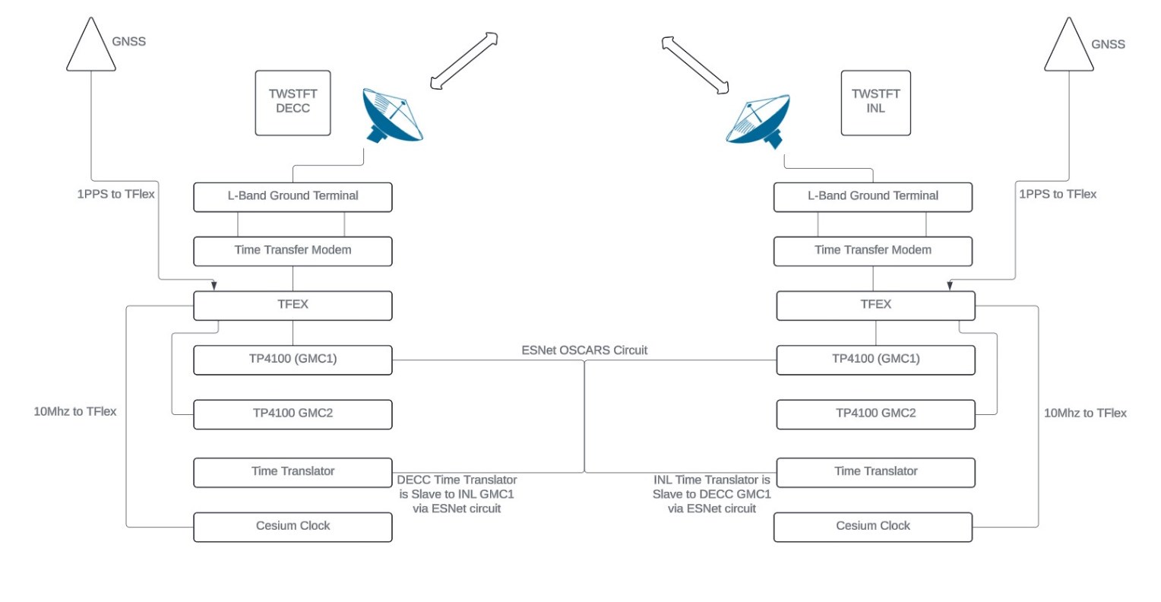
Comparison of Two-Way Satellite Time and Frequency Transfer (TWSTFT) and PTP over long Distances
Geostationary Satellite
Figure shows the details on the TWSTFT setup between ORNL and INL as well as PTP over ESnet for the comparison purpose.

Slide 5
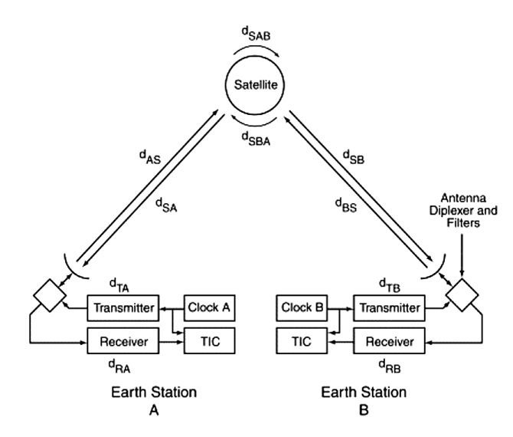
Two-Way Satellite Time and Frequency Transfer (TWSTFT): Why is it Important?
Ability to synchronize timing systems over a large geographic area where traditional terrestrial communications mediums may either not be available or may not be practical from a performance standpoint.
Pros: good timing accuracy (less than 50 ns) over large geographic areas and ability to synchronize multiple sites
Cons: cost and complicated setup
Geostationary Satellite

Slide 6
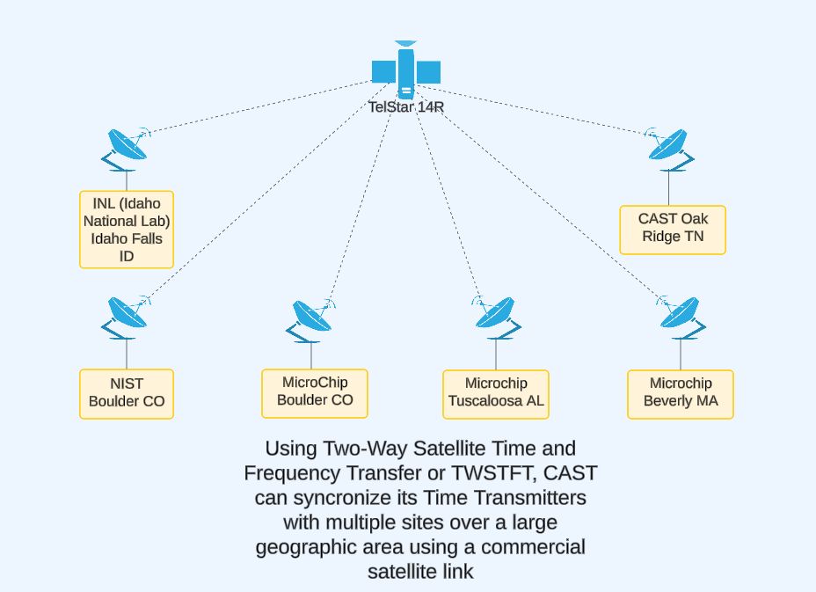
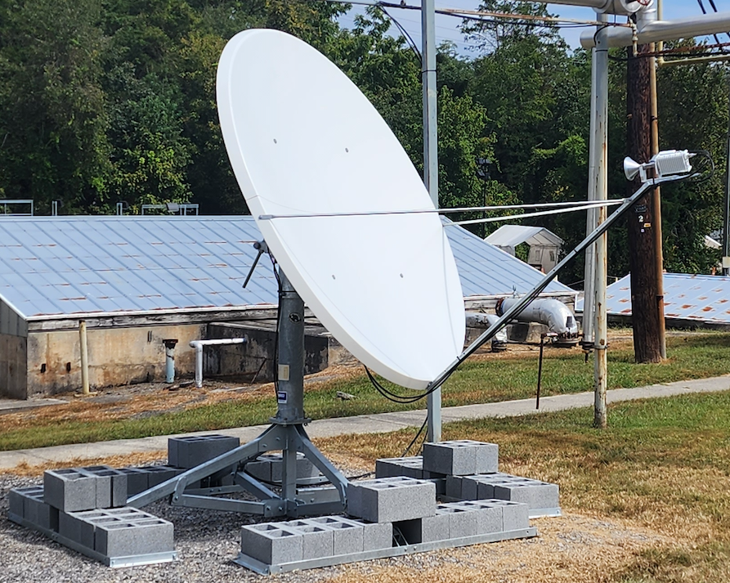
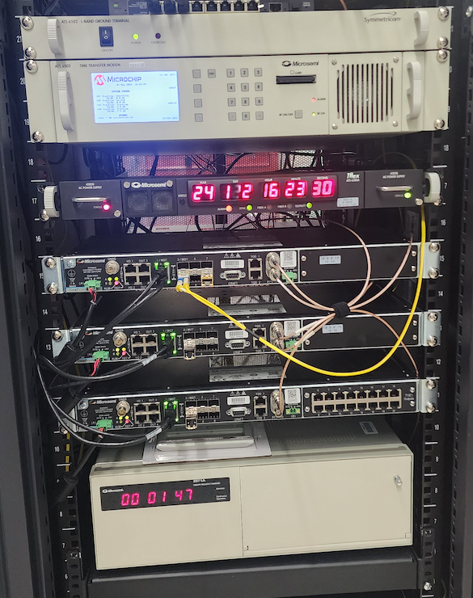
CAST/MicroChip TWSTFT Capabilities
Geostationary Satellite
Transfer time from a master node with atomic clock to other sites without atomic clocks.
Benchmarking long distance PTP over EsNet using TWSTFT as reference.
Greater resilience against jamming and spoofing compared to GNSS.
Loss of connection at one site does not affect others, providing a robust and redundant time transfer solution.
TWSTFT use as regional hub, providing timing to local sites.

Slide 7
TWSTFT Experiment Phases with NIST, INL, and MicroChip
Phase 1 (FY 24) – Established satellite communications and connecting CAST and NIST. Once connected we validated the stability and accuracy of the timing signal.
Phase 2 (FY 25) – Added 3 MicroChip sites and confirmed the stability and accuracy of the timing signal.
Phase 3 (FY 25) – Added INL, confirmed the stability and accuracy of the timing signal and compare the performance to each site.

Slide 8
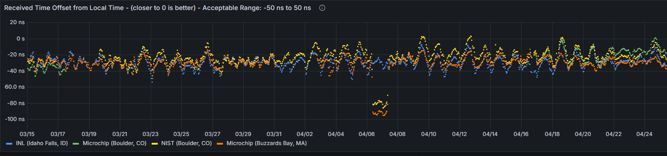
TWSTFT Current Performance NIST, INL, and Microchip
Achieve Synchronization with NIST UTC Within 10 Nanoseconds

Slide 9

Challenges Faced during the TWSTFT Experiments
Some of the equipment was less than user friendly
Site outages due to equipment failure and severe weather (which required dish repointing)
Pointing the dish to the correct satellite azimuth and elevation
Resyncing different sites when we changed from one satellite provider to another

Slide 10
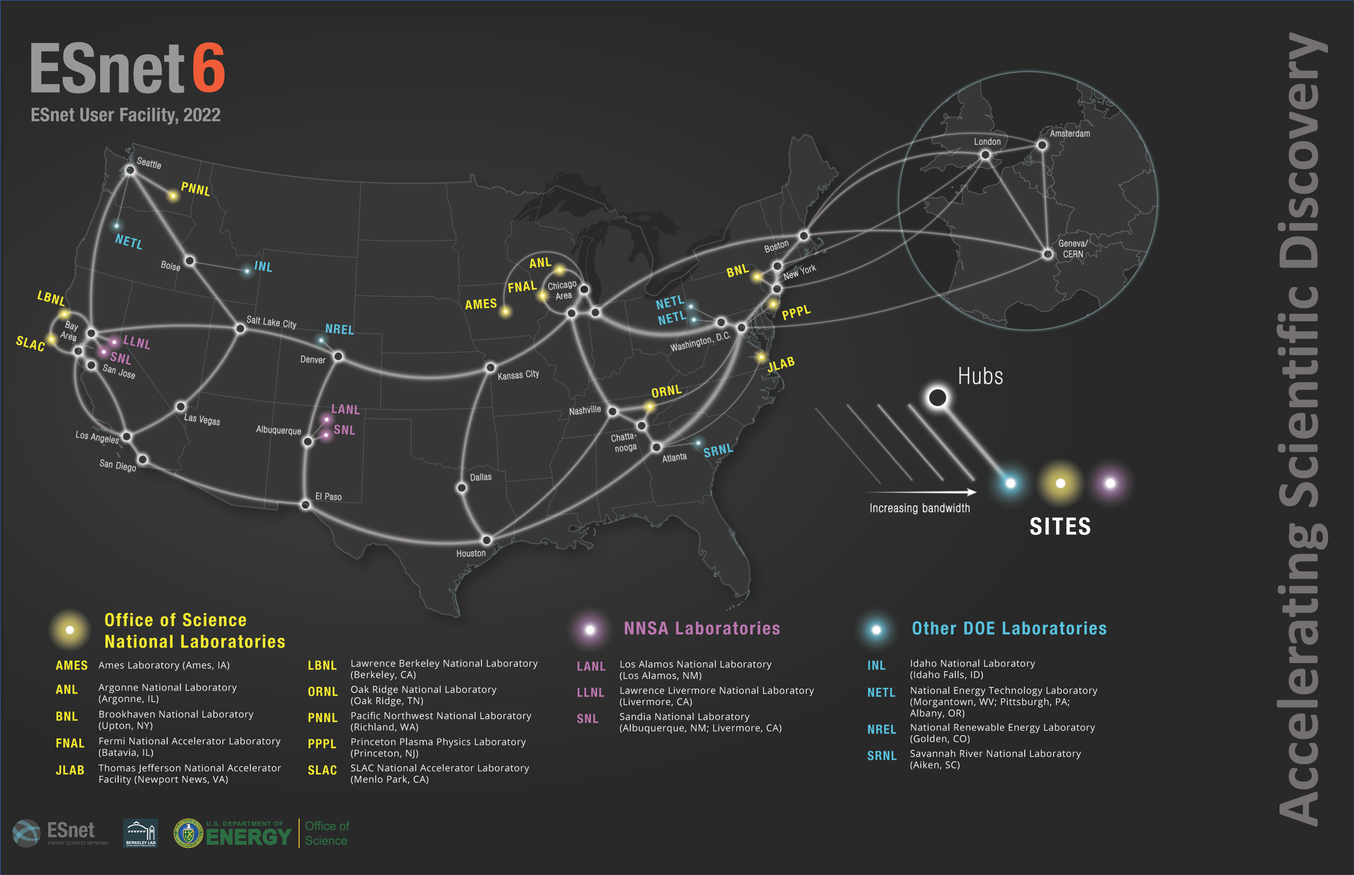
DOE’s Energy Sciences Network (ESNet) OSCARS
Funded by the U.S. Department of Energy (DOE) Office of Science and managed by Lawrence Berkeley National Laboratory, the Energy Sciences Network (ESnet) was created in 1986 to provide dedicated high-performance network connectivity for DOE researchers.
ESnet's high-performance network connects 17 national laboratories, 28 user facilities, and 270 research & education and commercial networks.
OSCARS On-Demand Secure Circuits and Advance Reservation System

Slide 11
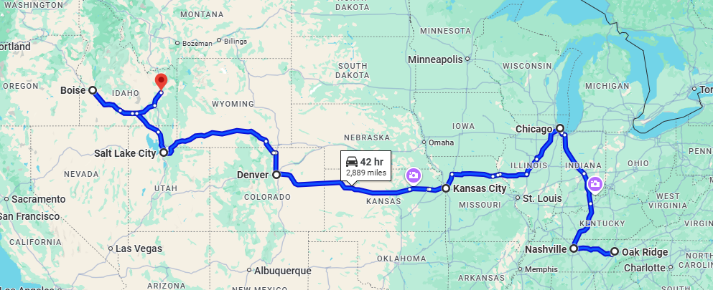
ORNL<>INL PTP performance
Esent fiber link between ORNL-NL ~3000 Miles

Slide 12
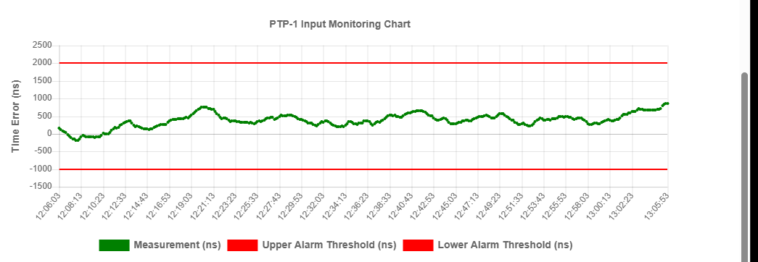
ORNL<>INL PTP performance
PTP Performance between ORNL<> INL < 1us

Slide 13
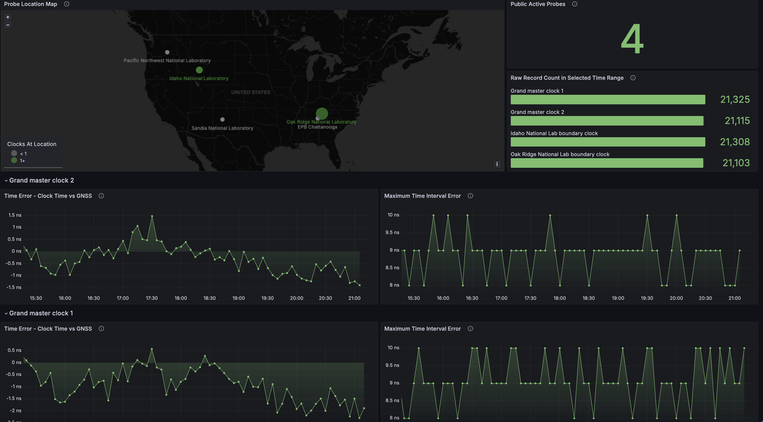
Conclusions
TWSTFT is excellent for wide-area synchronization and achieves 10 nanoseconds accuracy
PTP can be a strong alternative to GNSS, offering less than 1 microseconds accuracy over long distances
CAST can provide synchronization and timing without relying on GNSS

Slide 14
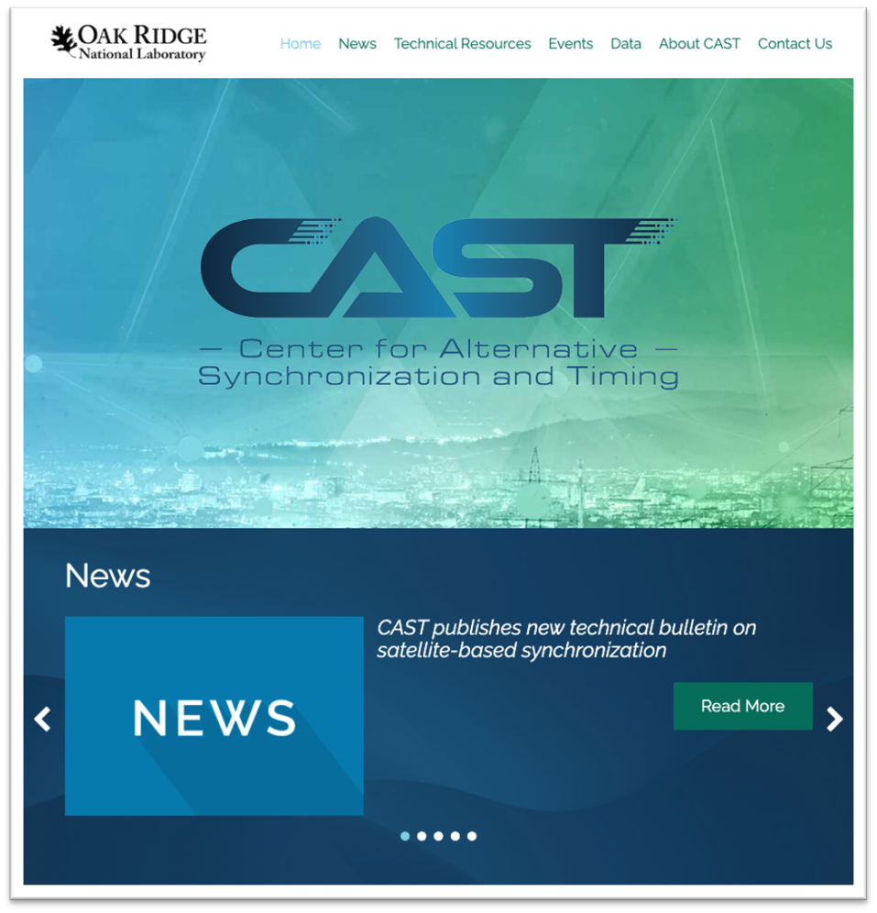
Building a Community through Partnerships & Engagement
Webpage: https://cast.ornl.gov

